Slide 1


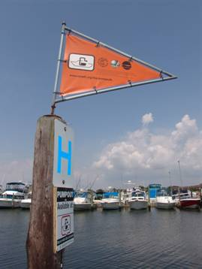
Clean Vessel Act Regulation Update Open Forum Discussion
SOBA Conference
Little Rock, AR
October 2014
Lisa E. Van Alstyne

Slide 2
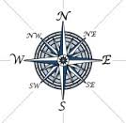
CVA Rule Overview
Currently we have published 3 final guidance documents in the Federal Register
The CVA Final Rule (March 10, 1994)
CVA Technical Guidelines (March 10, 1994)
The CVA Program Symbol (August 27, 1997)
We will combine these into 1 regulation and an Appendix.

Slide 3
Next Steps
Open Forum – SOBA Conference
Webinars – Open to all, November – December 2014. Potentially more in 2015.
Wiki – We will use the WSFR Wiki to solicit comments for topics and drafts
1st Complete Draft > Review within FWS
2nd Complete Draft >Review by all
partners

Slide 4
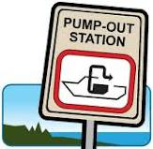
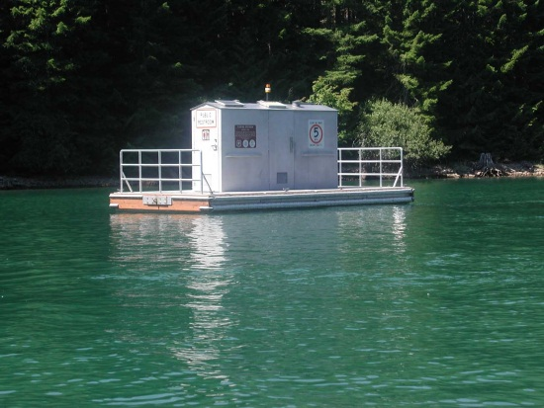
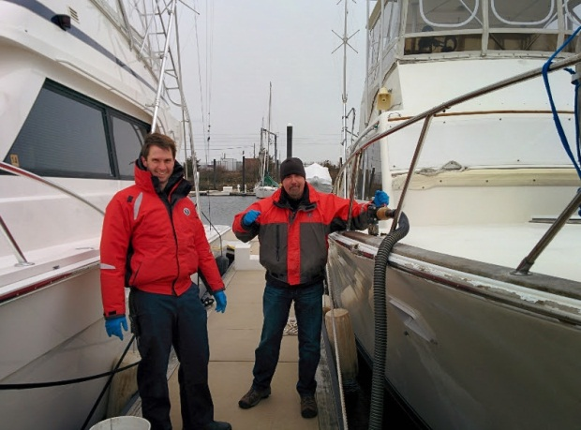
Today’s Topics
Coastal/Inland “Split”
Fees
Operation and Maintenance

Slide 5
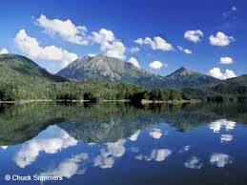
Coastal / Inland
The Safe, Accountable, Flexible, Efficient Transportation Equity Act: A Legacy for Users (2005) removed the Coastal preference:
SEC. 10131. GRANT PROGRAM.
Section 5604(c)(2) of the Clean Vessel Act of 1992 (33 U.S.C.1322 note) is amended—
(1) by striking subparagraph (A);
(2) by redesignating subparagraphs (B)
and (C) as subpararaphs (A) and (B),
respectively;
Notes:
This will be corrected in the updated regulation.
Background:
COASTAL PREFERENCE ISSUE: Review done May 2010, L. Van Alstyne
The Clean Vessel Act of 1992 - Public Law 102-587, title V, subtitle F (106 Stat 5039), November 4, 1992, included the following section: (Incorporated into Title 33—Navigation and Navigable Waters § 1322
5604. FUNDING
…..(c) GRANT PROGRAM
…..(2) PRIORITY. —In awarding grants under this subsection, the secretary of the interior shall give priority consideration to grant applications that—
(A) in coastal States, propose constructing and renovating pumpout stations and waste reception facilities in accordance with a coastal State’s plan approved under section 5603(c);
(B) provide for public/private partnership efforts to develop and operate pumpout stations and waste reception facilities; and
(C) propose innovative ways to increase the availability and use of pumpout stations and waste reception facilities.
Amended by Public Law 109-59, title X, § 10131, August 10, 2005 (119 Stat 1931):
CHAPTER 2—CLEAN VESSEL ACT OF 1992 AMENDMENTS
SEC. 10131 GRANT PROGRAM.
Section 5604(c)(2) of the Clean Vessel Act of 1992 (33 U.S.C. 1322 note) is amended—
(1) by striking subparagraph (A);
(2) by redesignating subparagraphs (B) and (C) as subparagraphs (A) and (B) respectively; and
(3) in subparagraph (A), as so designated, by striking “receptions” and inserting “reception”.
The result of this change is:
5604. FUNDING
…..(c) GRANT PROGRAM
…..(2) PRIORITY. —In awarding grants under this subsection, the secretary of the interior shall give priority consideration to grant applications that—
(A) provide for public/private partnership efforts to develop and operate pumpout stations and waste reception facilities; and
(B) propose innovative ways to increase the availability and use of pumpout stations and waste reception facilities.
The 2005 Amendment removed the Coastal preference.

Slide 6
Pumpout Fees
* Current language
§85.44 Fee charges for use of facilities.
A maximum of a $5.00 fee may be charged, with no justification¹, for use of pumpout facilities constructed, operated or maintained with grant funds. If higher fees are charged, they must be justified² before the proposal can be approved. Such proceeds shall be retained, accounted for, and used by the operator to defray operation and maintenance costs³ as long as the facility is needed and it serves its intended purpose. The maximum fee shall be evaluated for inflation⁴, etc., each year.
Highlights and superscripts added for discussion purposes.

Slide 7
4 Major Components
$5 maximum w/out justification
Higher fee considered if justified
Must use fee for O & M
Fee increases with inflation
1, 2, & 4 all relate to amount of Fees
Notes:
If fees are too high, then boaters are less likely to use pumpouts? Where is the balance?
Pumpout operators that must pay for holding tank disposal vs. municipal disposal – is there a significant difference?
What about pumpout boats that give the additional service of coming to the boater and incur greater costs?

Slide 8
Discussion Topics
Fees:
Should the maximum be increased?
What are the pros and cons of higher fees?
Are there alternatives to a maximum fee?
How do we balance fees and boater usage?
Should the fees schedule vary depending on disposal options or service delivery?

Slide 9
Fee Structure Discussion Analysis
Holding Tank Size (gallons) | Fees per Gallon | Total Charge for 30 gallon pumpout | Total fees collected for each 1,000 gallons
1,000 | $ 0.15 | $ 4.50 | $ 150.00
1,000 | $ 0.20 | $ 6.00 | $ 200.00
1,000 | $ 0.25 | $ 7.50 | $ 250.00
1,000 | $ 0.30 | $ 9.00 | $ 300.00
Would one of these amounts be useful as a sliding scale? If so, what is the maximum?
Will this pay for disposal fees?
Will boaters pay this much?
Notes:
Not all pumpouts (likely very few) have flow meters, so literally charging by the gallon could be difficult.

Slide 10

Survey Question
What is the CVA Fee structure in your State?
 |  | # Responded
A. | Straight $5 fee, no exceptions.
B. | Straight $5 fee with some exceptions, as justified.
C. | A sliding scale fee with $5 for up to a certain number of gallons and a higher fee above that.
D. | A flat rate higher than $5.
E. | Other.

Slide 11
Operation and Maintenance
As it relates to fees:
Such proceeds shall be retained, accounted for, and used by the operator to defray operation and maintenance costs as long as the facility is needed and it serves its intended purpose.

Slide 12
Discussion Topics
O&M
1) How important is it for operators to account for
fees?
2) Knowing the costs associated with operating and
maintaining pumpouts, should we just accept it is
not a “money maker” for an operator?
Or, do we need that accounting?
3) Do/should States that offer funding for O&M
require the grantee to deduct collected fees from
their costs when applying for a grant?

Slide 13
Survey Question
Does your State offer CVA funds for O & M?
 | # Responding
Yes
No
For those States that offer CVA funds for O&M, do you:
 |  | # Responding
A. | Offer O & M as a separate grant program?
B. | Include O & M as part of the construction grant?
C. | Other?

Slide 14
Discussion Topics
O&M
Considering O&M as an issue outside of Fee collection:
4) If your State does NOT offer an O&M grant
program, why not?
5) Is it possible that a change in the regulations would make it easier for your State to participate? If so, what would the change(s) be?

Slide 15
Operation Definition
Wiki
Operation means actions, supplies, and labor needed to carry out the purpose of the pumpout facility and make it work. Operation may include:
(1) Fuel, dock fees, and insurance for pumpout boats;
(2) Emptying waste holding tanks;
(3) Transporting waste from the pumpout facility to the municipal or commercial waste treatment facility;
(4) Hepatitis shots, gloves, sanitizer, and other items for the protection of pumpout personnel;
(5) Maintaining a pumpout log; and
(6) Labor specific to the pumpout facility.

Slide 16
Operation Definition
Wiki
Operation must not include:
(1) Municipal sewage, water, electric or other utilities shared by other marina activities;
(2) Labor that benefits other than pumpout facilities;
(3) Food, beverage, uniforms, or other personal items used or worn by staff, even if operating the pumpout facility;
(4) Travel expenses for staff to get to and from a pumpout location; and
(5) The full cost of a general dockhand.

Slide 17
Maintenance Definition
Wiki
Maintenance means keeping structures and equipment in a condition to serve the intended purpose. It includes cyclical or occasional actions done to keep pumpout facilities fully functional.
These may include:
Routine activities performed on equipment to keep it in good working order, such as applying lubricant, inspecting pipes, verifying working order of seals and valves, adjusting belts, checking electrical connections, winterizing equipment, applying shrink wrap for pumpout boats, or other pro-active measures;
Replacing of equipment parts and fluids to keep it in good working order, such as changing oil, changing belts, replacing worn parts;

Slide 18
Maintenance Definition
Wiki
Repairing, replacing, or upkeeping structures and appurtenances directly supporting the equipment at the pumpout facility. See § 85.XX
Improving access to the equipment through actions such as removing weeds around equipment, repairing and replacing lighting, or monitoring the pumpout slip for access;
Supplies, materials, tools, and labor needed to carry out above activities; and
(6) Inspecting pumpout facilities.

Slide 19
Webinars
Be watching for information on upcoming webinars. Sign up for the SOBA List Serve if you haven’t already and check the News link on our Web site at:
wsfrprograms.fws.gov

Slide 20
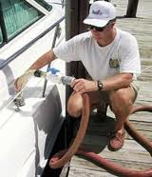
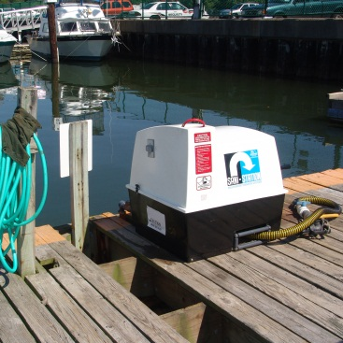
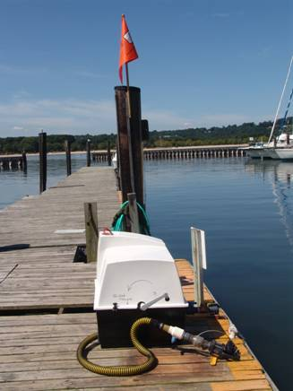

Thank you!
Your expertise and participation in the process of updating the CVA regulations is invaluable –
Wiki
http://fawiki.fws.gov
Communicate with:
Regional Coordinator
States
SOBA, SFBPC, other groups here
Grantees….

Slide 21

Contact:
Lisa E. Van Alstyne
Fish and Wildlife Administrator
FWS, WSFR Branch of Policy
Lisa_Van_Alstyne@fws.gov
703.358.1942
5275 Leesburg Pike
Falls Church, VA 22041

