Slide 1
BOATING INFRASTRUCTURE GRANTS PROGRAM
Program News, Funding Trends, and Tips for Preparing a Successful Proposal

Slide 2
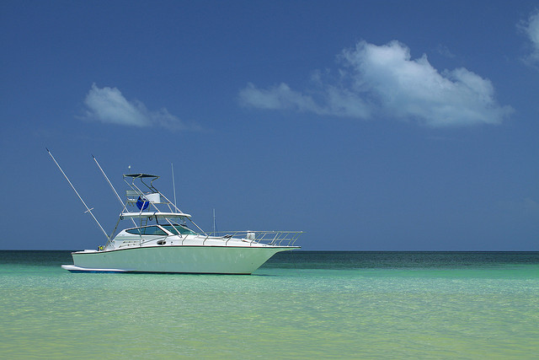
Boating Infrastructure Grants:
Supporting Those “Perfect Moments” On The Water…

Slide 3
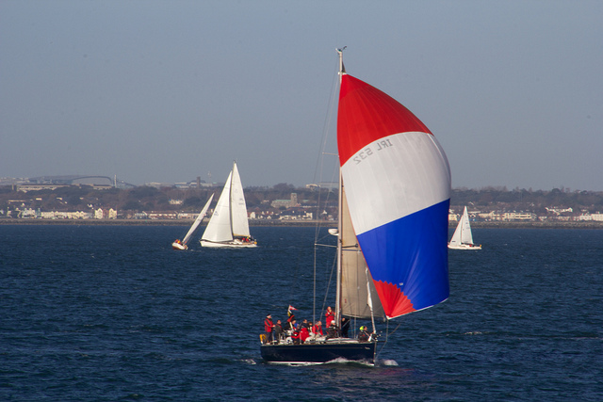
Boating Infrastructure Grants:
Supporting Those “Perfect Moments” On The Water…
“Sailing Boats” Photo by Dan Heap

Slide 4
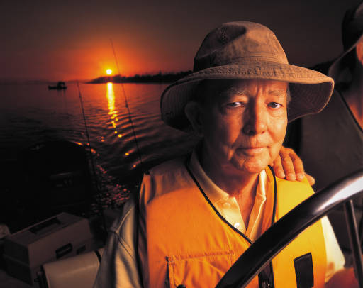
Boating Infrastructure Grants:
Supporting Those “Perfect Moments” On The Water…

Slide 5
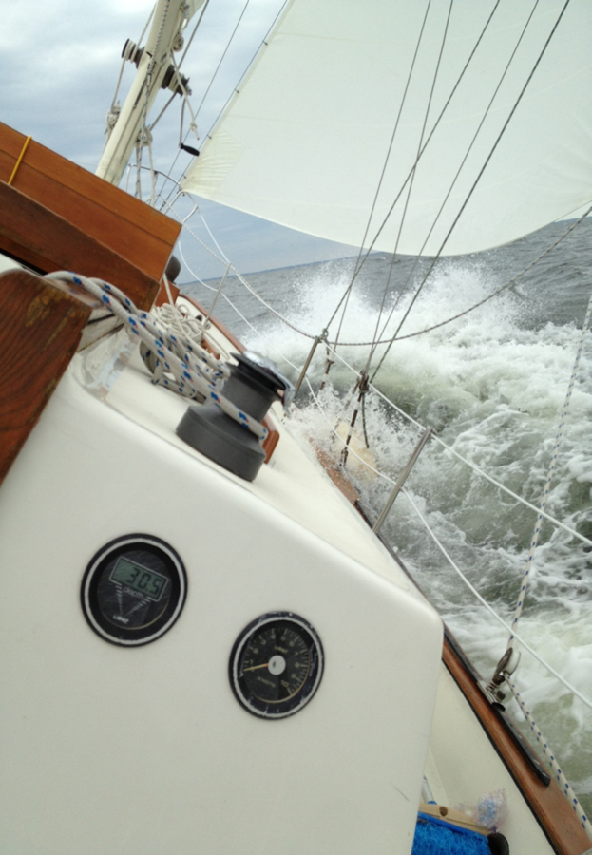
Boating Infrastructure Grants:
Supporting Those “Perfect Moments” On The Water…

Slide 6
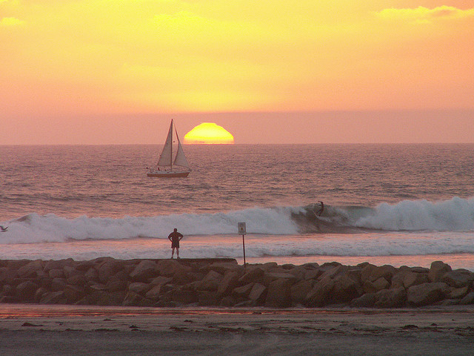
Boating Infrastructure Grants:
Supporting Those “Perfect Moments” On The Water…

Slide 7
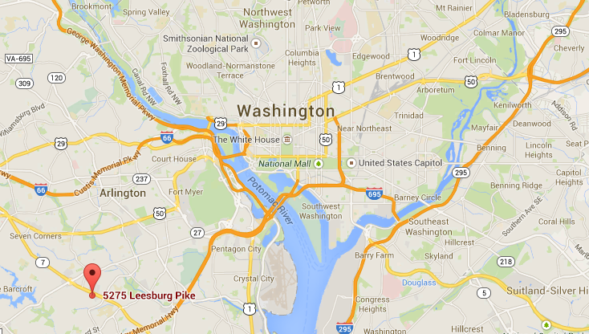
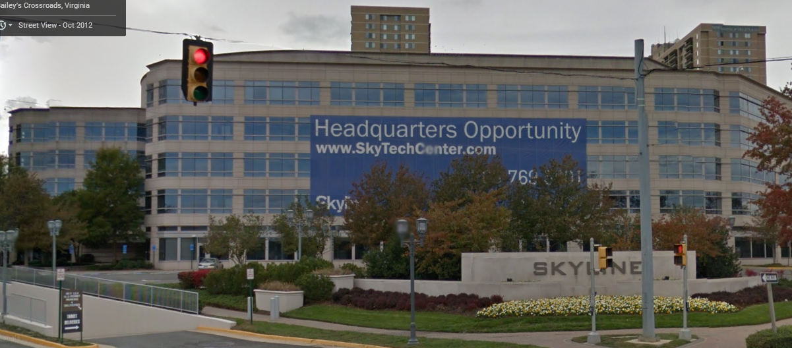
Program News
WSFR Has Moved!
U.S. Fish and Wildlife Service Headquarters
MS: WSFR
5275 Leesburg Pike
Falls Church, VA 22041-3803

Slide 8
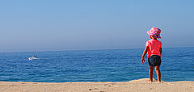
Program News
FY15 BIG Grants will be scored using the current rule’s criteria.
We’ve requested a “budget justification” for the first time in FY15.
Ranking will take place in early December with the Sport Fishing and Boating Partnership’s team.
The consolidated “Supercircular” will likely be in place by the time FY15 BIG money is obligated.
Photo: Ian D. Keating

Slide 9
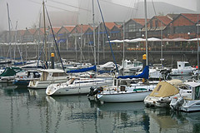
Program News
WSFR Programs piloted a pre-award teleconference for state agencies interested in applying for FY15 BIG funds (on August 26).
Some lessons learned...but overall the feedback was positive.
Next year’s pre-award teleconference topics:
  New BIG Rule and how it impacts you as an applicant.
  The “Supercircular” and Administration of BIG funds.
  Other?
“Fog and Boats” Photo: Francisco Antunes

Slide 10
Funding Trends: Tier 2
Tier 2 Projects, FY2001-2014
Public vs. Private Subgrantees
Source: Director's approval memos

Slide 11
Funding Trends
BIG TIER 2 AWARD TOTALS, FY2001-2014
Source: Director's approval memo's

Slide 12
Funding Trends
Top 20 Tier 2 States by No. of Projects
Source: Director’s Award Memo’s, FY2001-2014

Slide 13
Funding Trends
Top 20 Tier 2 States by Total Dollar Amount
Source: Director’s Award Memo’s, FY2001-2014

Slide 14
Funding Trends: Tier 2
Top 10 States Receiving Tier 2, 2001-2014
By Number of Awards |  | By Total Amount Awarded
California | 21 | California | $18.0 M
Virginia | 19 | Florida | $13.0 M
Oregon | 16 | Ohio | $7.8 M
Florida | 15 | Illinois | $7.0 M
New Jersey | 11 | Oregon | $6.6 M
New York | 8 | New Jersey | $6.2 M
Texas | 8 | Michigan | $6.2 M
S. Carolina | 8 | S. Carolina | $5.7 M
N. Carolina | 7 | Virginia | $5.6 M
Maine | 7 | New York | $4.7 M

Slide 15
Funding Trends: Tier 2
Requested vs. Awarded, 2007-2014
Source: Director’s approval memos

Slide 16
Funding Trends: Tier 2
Award Ratio (Total Awarded: Total Requested), 2007-2014 Source: Director’s Award Memos

Slide 17
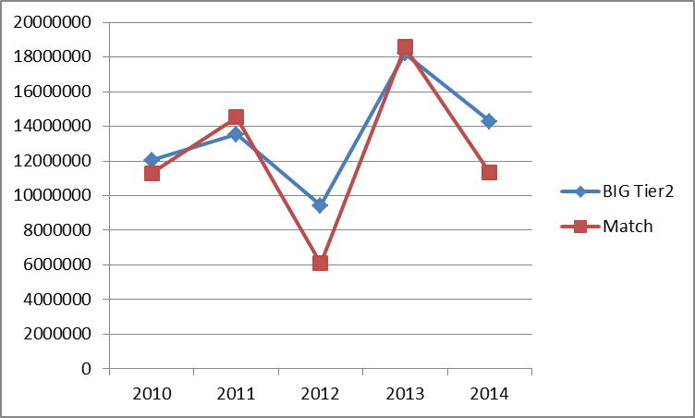
Funding Trends: Tier 2
Total Awarded vs. Total Match, 2010-2014
Source: Director’s Award Memos

Slide 18

Tips for Preparing a Successful Proposal
Read the instructions carefully
Start early and request a pre-deadline review
    Three weeks or more before the deadline
    Your Regional Coordinator or HQ staff will assist
“A Boating Affair”- Photo
by Kevin Dooley

Slide 19
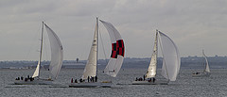
Tips for Preparing a Successful Proposal
More is not necessarily better. Watch those page limits.
Append photos and figures rather than inserting in the narrative.
Make sure everything matches up:
    Drawings or Plans match with Narrative Description
    Budget figures are the same on SF-424, Narrative, Letters of Support
Photo:
Barry Skeates

Slide 20
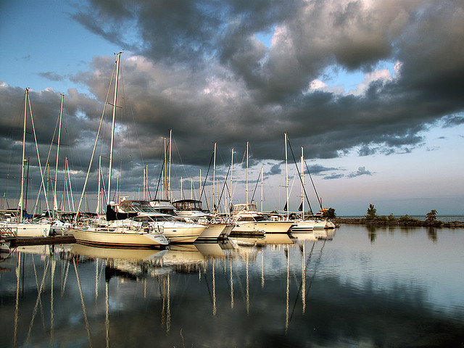
Tips for Preparing a Successful Proposal
Common problems:
    Dredging: cannot exceed 10% of total project costs.
    Letters: document all matching funds (including matching funds from the sub-grantee)
    Prorated costs: Explain your reasoning, cite evidence.
“Boats” Photo by Robert

Slide 21
Tips for Preparing a Successful Proposal
A well designed budget (example):

Slide 22

Tips for Preparing a Successful Proposal
Didn’t get a grant?
    Don’t give up: try, try again.
    Contact your Regional Coordinator to request input.
    You asked, we listened: aggregate score by criterion will be available next year.
“Boating on Lake Michigan.” Photo by Kevin Dooley

