Slide 1


Clean Vessel Act
Program Update
Christy Vigfusson, U.S. Fish and Wildlife Service

Slide 2
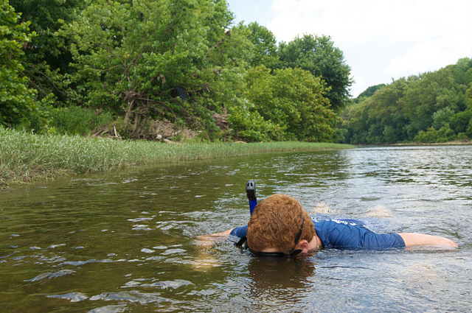
Clean Vessel Act Grants:
Supporting Clean Water…

Slide 3
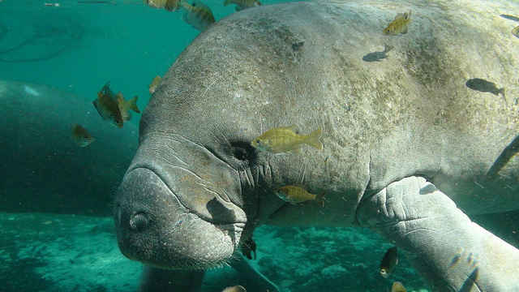
Clean Vessel Act Grants:
Supporting Clean Water…

Slide 4
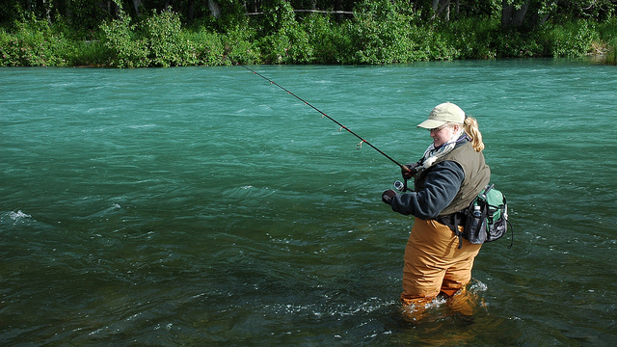
Clean Vessel Act Grants:
Supporting Clean Water…

Slide 5
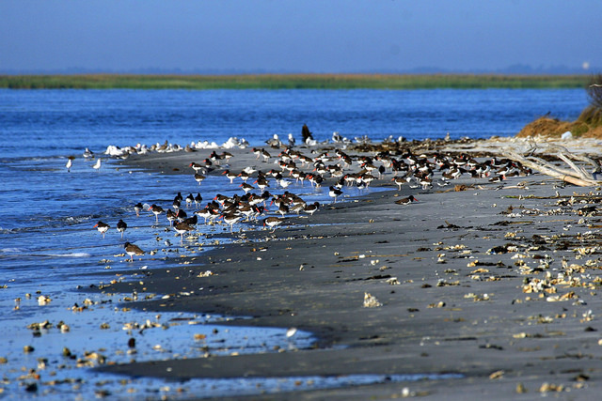
Clean Vessel Act Grants:
Supporting Clean Water…

Slide 6

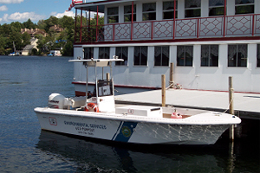
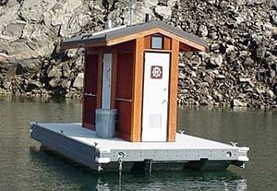
Clean Vessel Act
Provides grant funds to the States, the District of Columbia and insular areas for:
  Construction, renovation, operation, and maintenance of pumpout stations and waste reception facilities for recreational boaters.
  Educational programs that inform boaters of the importance of proper disposal of their sewage.
Notes:
Program has funded over 6,000 new pumpouts and funding to operate and maintain over 3,700 systems.
Over 860 education programs have been funded.

Slide 7
Clean Vessel Act
Each State, territory, and Commonwealth of the U.S. is eligible to apply.
Federal share for projects may be up to
$1.5 million each.
  Coastal States can apply for projects for both coastal and inland activities.
  Separate applications.
Minimum match required is 25% of total project costs (most insular areas first $200K match waived).

Slide 8
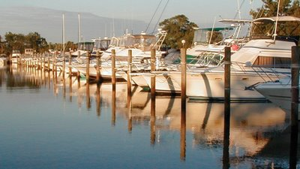
Clean Vessel Act – Source of Funds
Funds are provided annually from the Sport Fish Restoration and Boating Trust Fund.
Amount provided is 2% of the Trust Fund after several other deductions have been made, approximately $10-14 million.

Slide 9
CVA Fiscal Year 2014
Received 31 applications - 14 Coastal, 17 Inland
21 States applied – 10 applied for both Coastal and Inland Grants
All applications were fully funded - $16.59 million
States matched grants with $5.5 million
$3.1 million will carryover for use in FY 2015

Slide 10
CVA Fiscal Year 2015
Currently accepting applications through
December 3, 2014.
Apply through Grants.gov, CFDA 15.616
  Approximately $14 million will be available, $10-12 million in new funds and $3.1 million in carryover
If you have a program, think about how you can grow your program.

Slide 11
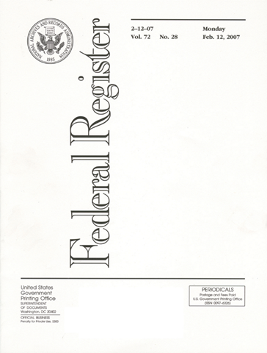
Program regulation revision
We will develop a revised draft of the CVA program regulation – 50 CFR 85.
We will share the draft with you through SOBA to get your input and feedback.
If you have any suggestions for input now, please let us know – send an email or call us.

Slide 12
Clean Vessel Act Funding Since 2000

Slide 13
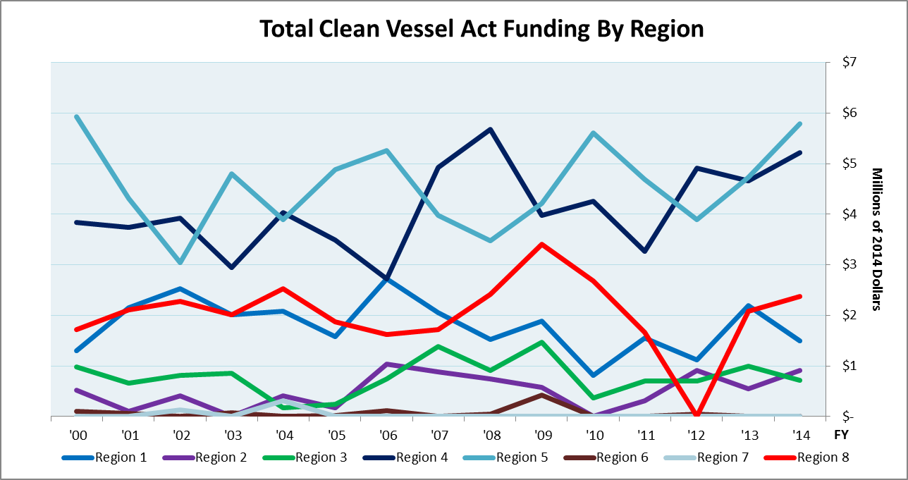
Clean Vessel Act Funding Since 2000
Notes:
This graph shows all of the 7 regions which received CVA funding of any kind in the past 15 years and how much they received total each year. As you can see, regions 4 and 5 regularly receive the most funding, while regions 6 and 7 participate less often and when they do, it’s for smaller amounts.
NOTE: All data is in 2014 dollars, adjusted for inflation. I used the Consumer Price Index to calculate yearly inflation in order to find real dollars.

Slide 14
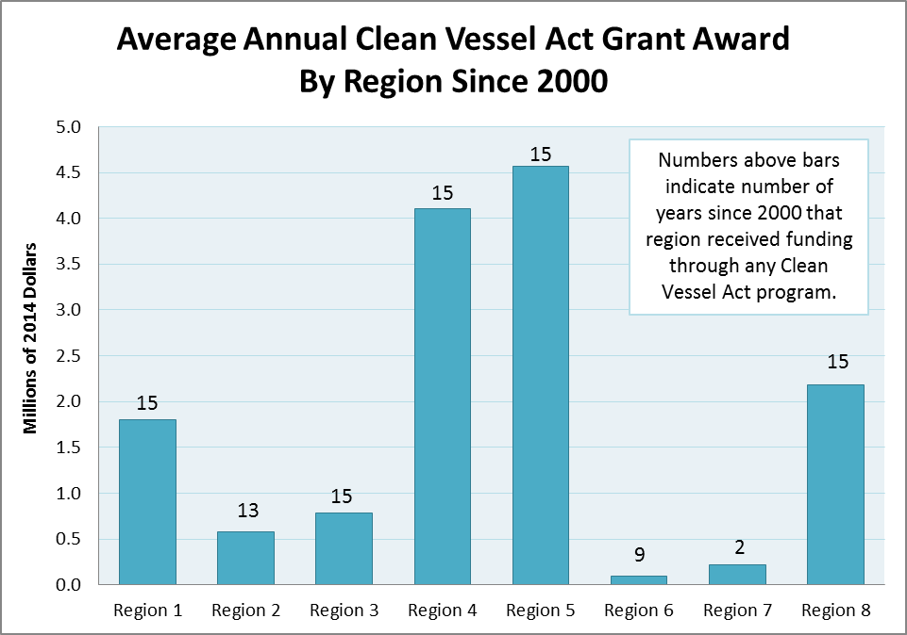
Notes:
In order to show a clearer comparison across regions, I took the average amount of funding that regions received in the last 15 years, excluding years in which no funding was awarded. Then, for comparison’s sake, I put above each bar the number of years since 2000 in which funding was received. In Regions 4 and 5, we see regular participation in the program (all 15 years), as well as high returns for their participation (averaging more than $4 million each year). Regions 2 and 3, despite their regular participation, consistently receive lower funding amounts. Regions 6 and 7 participate less frequently and receive the lowest funding amounts on average. Regions 1 and 8 regularly participate and receive a median amount of funding.
NOTE: All data is in 2014 dollars, adjusted for inflation. I used the Consumer Price Index to calculate yearly inflation in order to find real dollars.

Slide 15
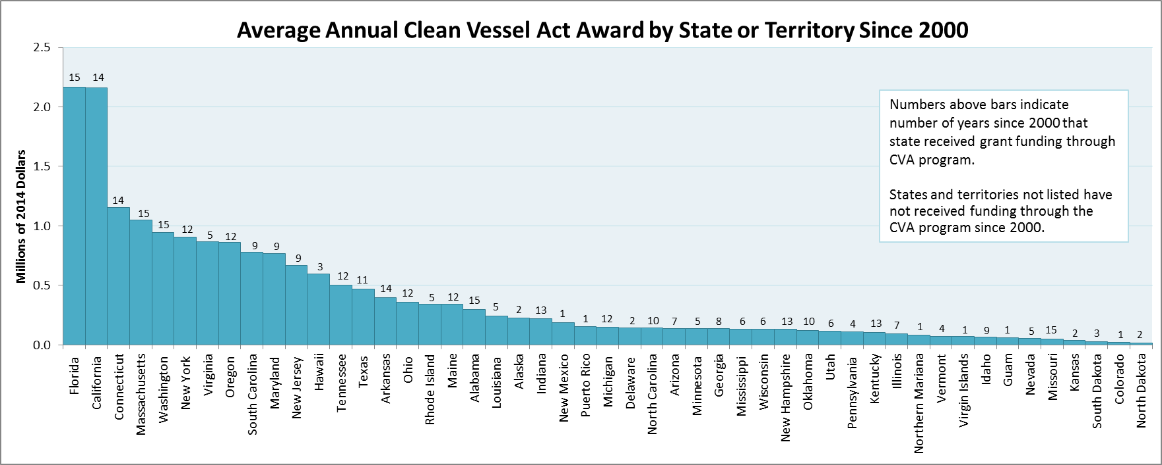
Clean Vessel Act Funding Since 2000
Notes:
This graph is similar to the last but is a breakdown by state, rather than region, with non-participating states excluded. The bars reflect the average amount of funding that a state has received over the last 15 years (since 2000). The general trend shows that states that participate more regularly also receive more funding and those that participate less frequently tend to receive less funding. There are a few exceptions to this trend, including Missouri, which has participated every year, but receives only small grant amounts, and states like Virginia and Hawaii which participate less frequently but average higher amounts when they do.
NOTE: All data is in 2014 dollars, adjusted for inflation. I used the Consumer Price Index to calculate yearly inflation in order to find real dollars.

Slide 16


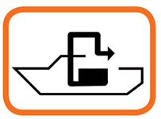
CVA Application ideas
The stronger your application, the more funding your project will receive if funds are competitive.
Maintenance of existing pumpouts , floating restrooms, and pumpout boats
Program administration
New facilities
Education programs

Slide 17
CVA Application Tips

