Slide 1
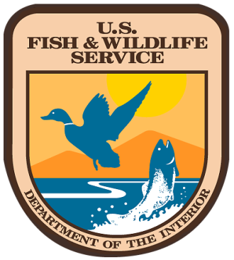
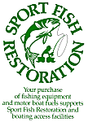
National coastal wetlands Conservation grant program Update
Christy Vigfusson, U.S. Fish and Wildlife Service

Slide 2
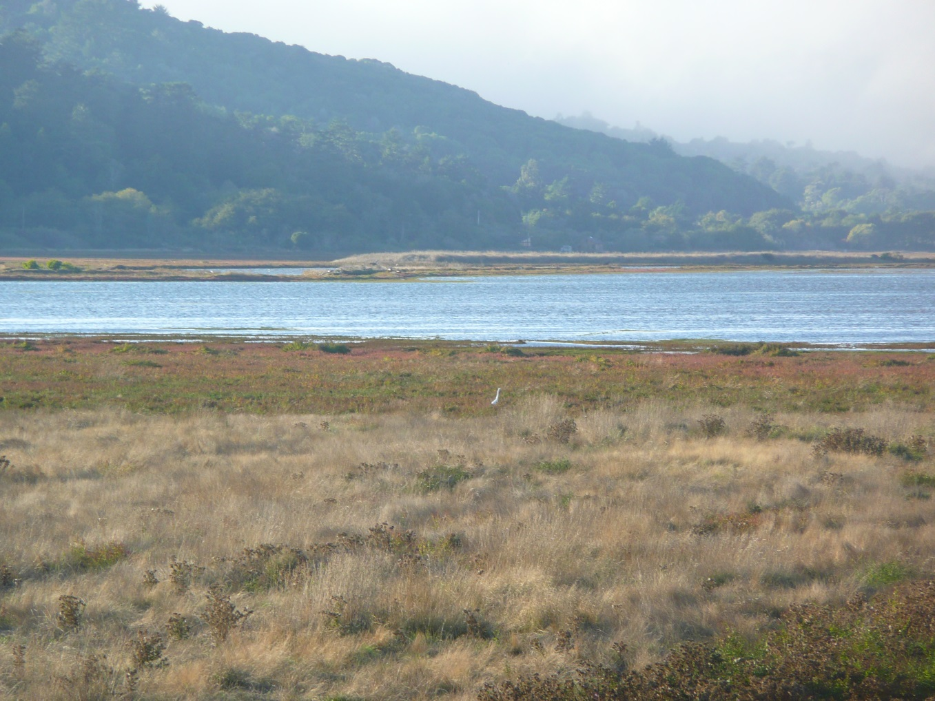
National Coastal Wetlands Conservation Grants
Provides grant funds to the States, the District of Columbia and insular areas for:
  Long-term conservation of coastal wetland ecosystems through acquisition and restoration in coastal lands and waters.

Slide 3
National Coastal Wetlands Conservation Grants FY 2014
Fiscal Year 2014
  WSFR awarded funding from the Sport Fish Restoration and Boating Trust Fund for:
    22 applications to
    12 States totaling
    $16.5 million
  The projects will cumulatively protect, restore or enhance approximately 11,247 acres of important coastal wetland habitat, including several miles of shoreline.
  Conservation of this habitat will not only benefit coastal-dependent federal trust species, but will also enhance flood protection and water quality, and provide economic and recreational benefits to commercial fishermen and sport anglers.

Slide 4
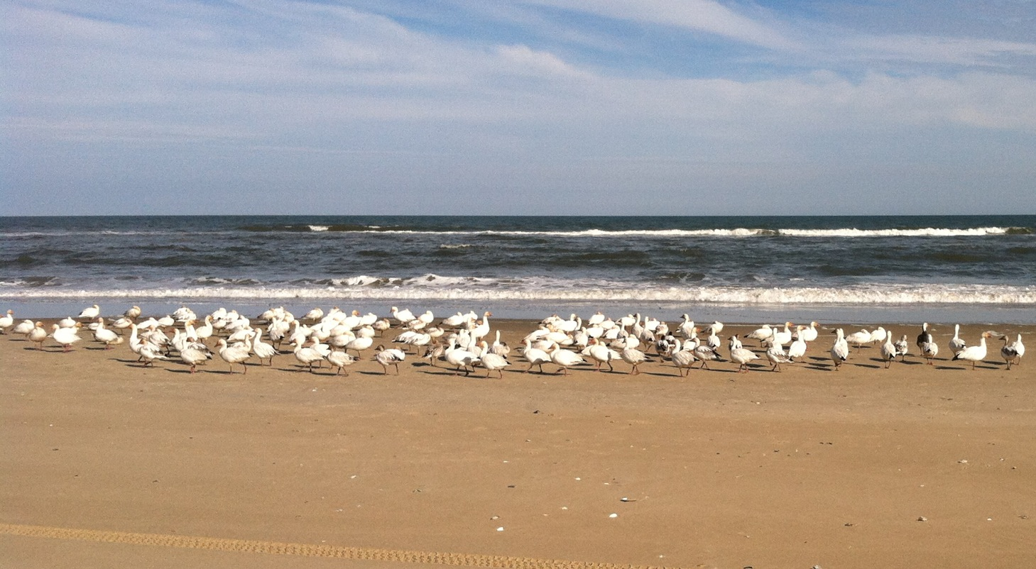
National Coastal Wetlands Conservation Grants FY 2015
In FY 2015, WSFR received
  36 applications from
  16 States requesting approximately
  $29 million
We anticipate $16 million in new funds, plus $1-4 million in recovered funds.

Slide 5
National Coastal Wetland Conservation Grant Application Tips
Read the Request for Applications or the NOFA – Notice of Funding Availability and Application Instructions
Address each ranking criteria individually – make it easy for reviewers to see what you will do and how to score
Have a great project and tell a great conservation story
Include partners and non-federal cash match (Criteria 10 and 11)

Slide 6
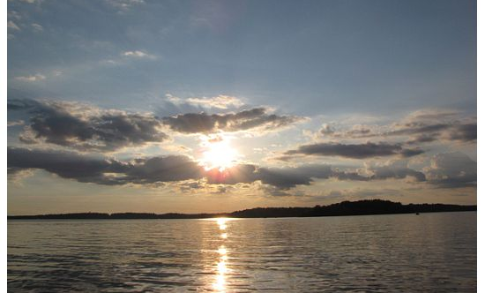
Thank you
christy_vigfusson@fws.gov
(703) 358-1748.

