Slide 1

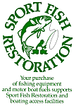
Recreational Boating Access
Subprogram of The Sport Fish Restoration Program
Christy Vigfusson, U.S. Fish and Wildlife Service

Slide 2
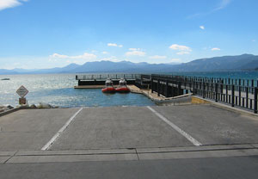
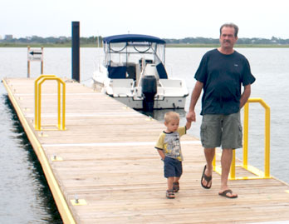
Recreational Boating Access
Provides grant funds to the States, the District of Columbia and insular area fish and wildlife agencies for projects that acquire, develop, renovate, maintain, or improve facilities that provide public access to the waters of the United States for recreational boating.

Slide 3
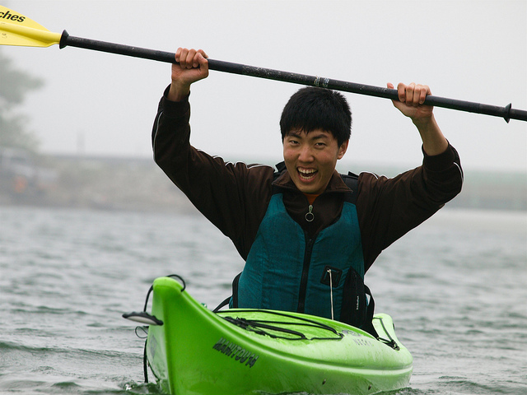
Recreational Boating Access Grants:
Supporting Public Access to those “Perfect Moments” on the water…

Slide 4
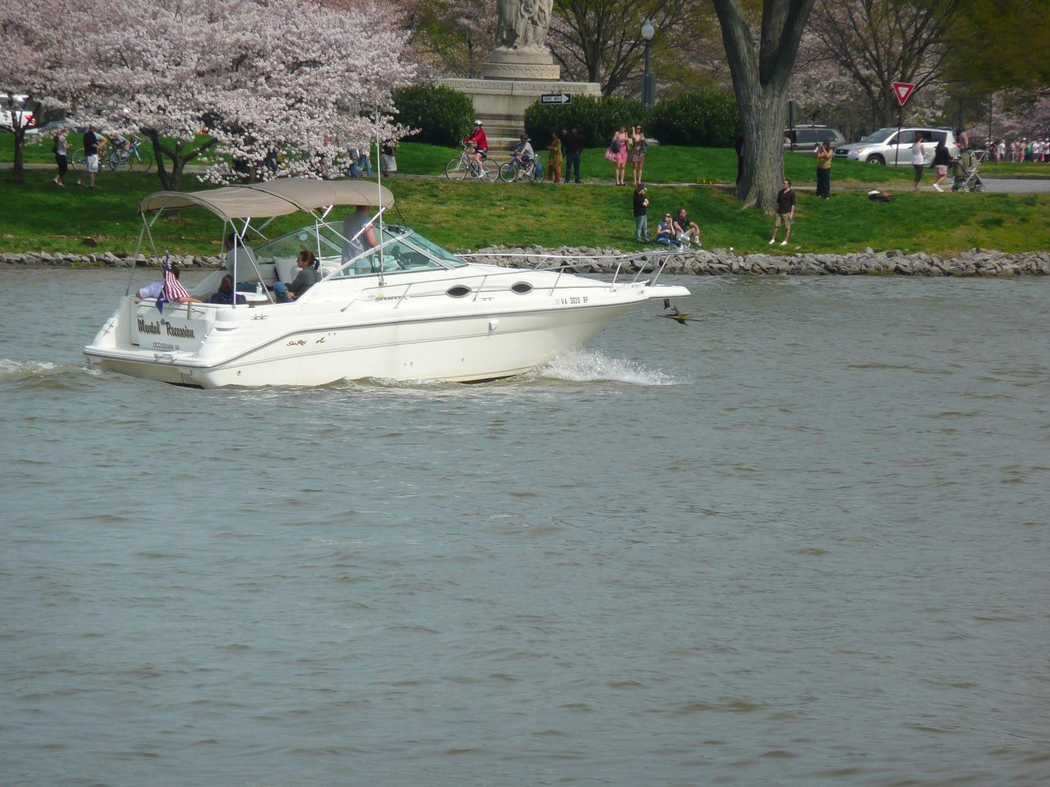
Recreational Boating Access Grants:
Supporting Public Access to those “Perfect Moments” on the water…

Slide 5
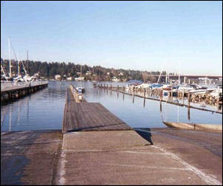
Recreational Boating Access
The Sport Fish Restoration Act mandates each State, the District of Columbia and insular area to allocate at least 15 percent of their annual Sport Fish Restoration apportionment to boating access projects.
  The allocation is averaged over a five year period for each U.S. Fish and Wildlife Service region.
  $48.86 million in FY 2014 nationally
Grant funds are disbursed to States for approved grants up to 75% of the project costs and insular areas up to 100% of the project costs.

