Slide 1


Multiyear License Certification
Taking Action to Find a Better Way
WSFR Branch of Policy
November 16, 2015

Slide 2
Multiyear License Certification
Multiyear licenses are a convenient way to sell hunting or fishing privileges for more than one season.
For licenses to count toward annual apportionments to States, they must generate a minimum net revenue for the State fish and game agency.
The question is how much revenue that should be.

Slide 3
Regulatory Language has Changed
1961 - First regulations at 50 CFR 80 published with little detail on license certification requirements.
1974 - Lots of new detail on license certification, first time regulation uses the word “commensurate” with regard to multiyear license revenue.
2008 - Net annual revenue from a multiyear license changed from “commensurate” to “in close approximation” to revenue for a single year license that grants similar privileges.
Since 2008 - Discussions on how to further clarify “in close approximation” and make the pricing requirements for multiyear licenses clearer for States to comply in a standardized way.

Slide 4
Proposed Regulatory Approach
Require a dollar value for minimum annual net revenue on multiyear licenses. Benefits of this approach include:
  Clearer, standard regulatory requirement.
  Based upon current national pricing structures.
  Measureable and “auditable” approach.
  Avoids need to compare license types to identify "similar privileges".

Slide 5
§ 80.35 How does an agency calculate minimum annual net revenue from a multiyear license?
(b) The agency must receive a minimum of $7.00 per year for each year during which a multiyear license is counted toward the total number of paid license holders for the annual apportionment.
Notes:
This is our proposed revision and new language for section 80.35(b). We propose revising the $7.00 value as needed, or on a regular interval of every 5 years (during the regulatory revision process.) Now, we’ll explain how we arrived at $7.00.

Slide 6
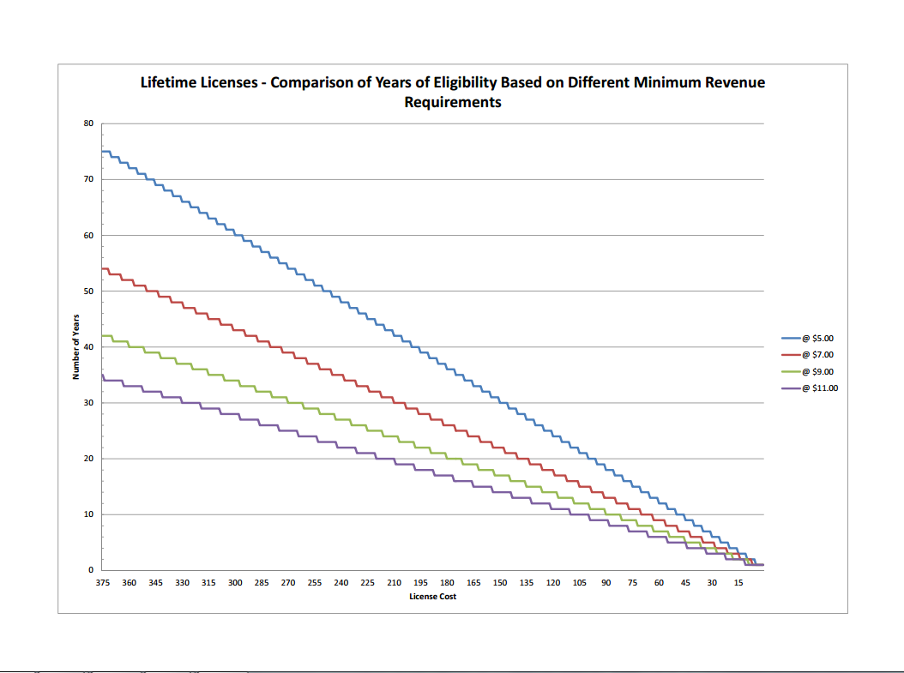
Average age when hunting/fishing license required: 16 years
Average American lifespan: 76 years
Average lifetime license price: $372
So, average period lifetime license is effective: 60 years.
Number of Years License Generates Revenue
The Cost of a Lifetime License

Slide 7
Proposed Actions
We identified the dollar amount that provides the optimal revenue to States for the optimal period of time.
For current license prices nationwide, $7.00 is the most appropriate minimum annual net revenue.
We propose to reevaluate this revenue level and adjust during each 5-year regulatory revision.

Slide 8
Moving Forward
This is a proposed revision to the multiyear license certification requirements.
We initiated this proposed revision at the request of States who want clarity in regulations.
Please provide feedback or any other ideas you have.

Slide 9
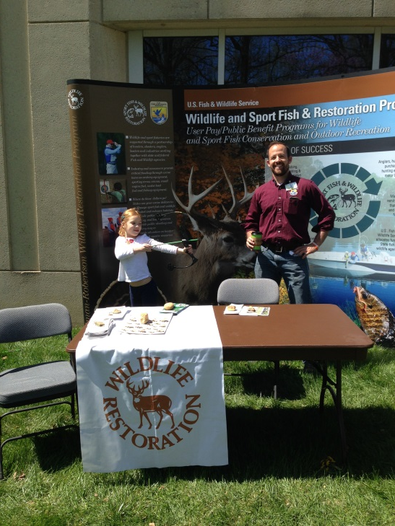



Questions?

