Slide 1
Collaborative Conservation Initiatives
Scott Knight and Shelley DiBona

Slide 2

Today, we will cover:
  Brief history of past challenges (OIG audit findings)
  Define Collaborative Conservation Initiatives (CCI)
  Terminology
  CCI administrative process
  Next steps going forward

Slide 3

CCI Development Team
Sherry Martin, HQ
Shelley DiBona, R5
LeAnne Bonner, R4
Diana Swan-Pinion, HQ
Ruth Utzurrum, R1
Dee Blanton, R5
Karen Bennett, HQ
Lisa Van Alstyne, HQ
Debbie Unbehagen, HQ
This Photo by Unknown Author is licensed under CC BY-NC-ND

Slide 4
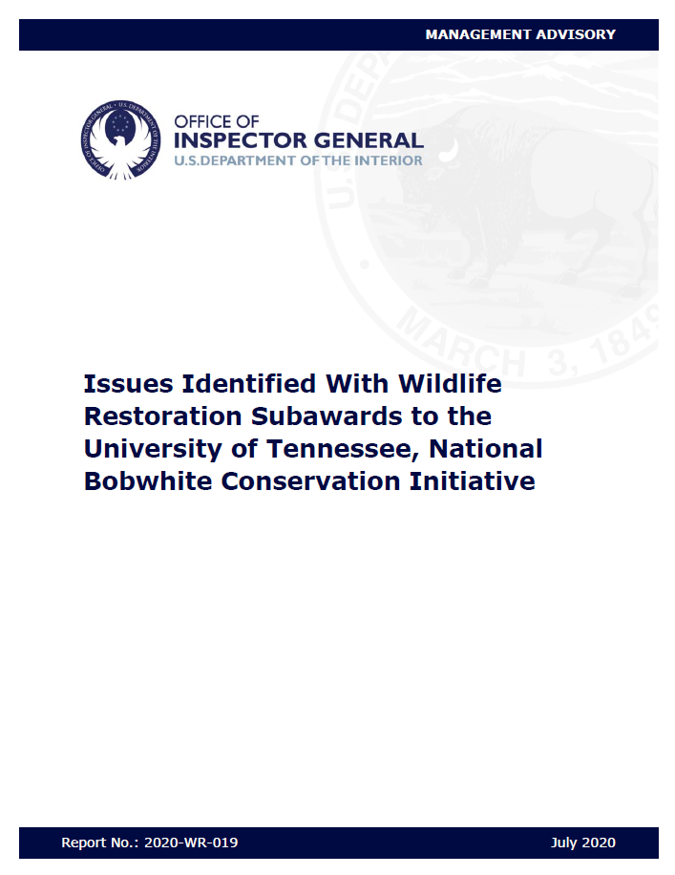
Management Advisory
2020-WR-019
“…nearing completion of multiple audits…, we observed issues with [State FW agency] subawards to NBCI…”
  NBCI accounting system cannot properly allocate costs.
  “Recharge Center” accounting methodology treated State subawards as fixed amount subawards.
  Costs charged to each State subaward, for NBCI activities, does not correlate to the benefits received.
  “Recharge Center (5 activity rates)” differ between Federal and non-Federal activities and because all costs are charged to a single subaccount, NBCI can not confirm that Federal awards are not be charged unallowable costs.
Notes:
NBCI’s accounting system currently possesses allocation limits which prevents it from properly allocating costs in proportion to the relative benefits received from each of the various individual agreements that they receive from States and other parties. Because of this, NBCI staff considered that collectively, all the different “monies” they received are just put into one big pot for which they use the pot to pay for all their activities. There was no reasonable methodology by which NBCI allocated their costs to each respective subaward.
NBCI used a “Recharge Center” accounting methodology which basically allowed NBCI to administer their various subaward agreements as fixed-amount subawards which are unallowable under 2 CFR 200 because the program requires a mandatory cost sharing requirement.
NBCI activities are not affected by the amount of funding provided by each State, respectively. As a results, each State receives the same amount of benefits, irrespective of the amount of funding provided (subawarded) by each State.

Slide 5

Discontinue State grant and/or license revenue funding to NBCI.
CI did not agree. Activities are eligible and such agreements help to achieve regional/national conservation efforts.
Resolve amount of questioned costs to NBCI.
CI did agree. However, NBCI’s efforts did result in the Wildlife Restoration program (and each participating State) receiving benefits, so no repayment will be necessary.
Identify other similar efforts throughout the WSFR program.
CI did agree. Other efforts were researched and evaluated for similarities.
Work with NBCI to develop compliant policies/procedures.
CI did agree. We are working on creating a mechanism for States to pool resources in partnership for regional/national conservation efforts.

Slide 6
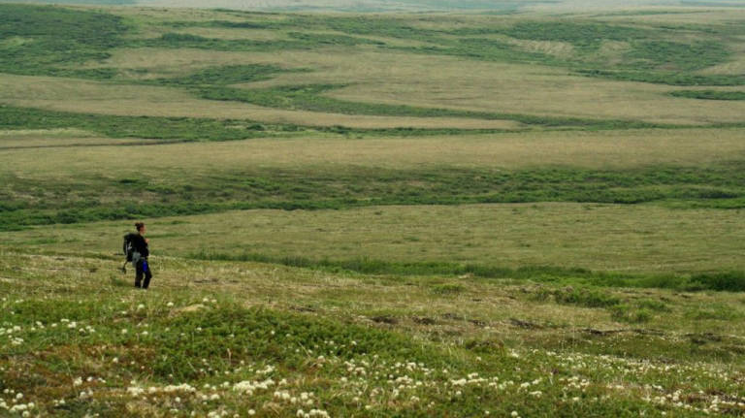
Collaborative Conservation Initiative
Refers to agreements between parties who work together to plan, fund, and/or implement projects designed to conserve regionally significant habitats and thriving populations of fish and wildlife resources across geopolitical boundaries.
  Must include awards to two or more States using WSFR, SWG, or C-SWG funds.
  CCI projects must provide a conservation benefit to each Participating State.
  Work is not necessarily required to occur within each Participating State.

Slide 7
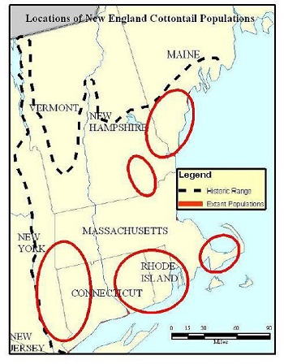
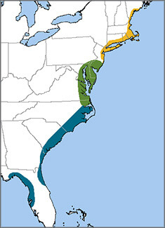
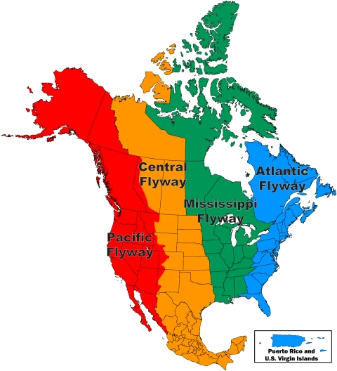
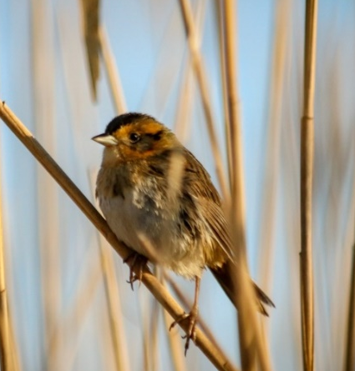
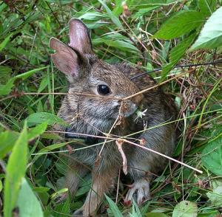
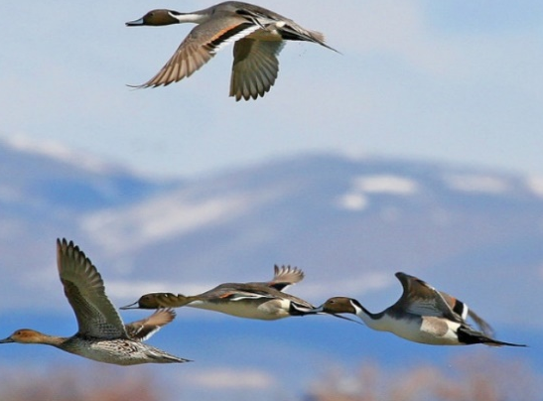

Landscape-Scale Conservation Successes
Notes:
Landscape-scale conservation is not a new idea. There are success stories of partners coming together for conservation.
This includes New England Cottontail. Once a “candidate” species for listing, the Service removed the cottontail as a candidate species, determining that, as a result of ongoing and planned implementation of conservation actions across multiple states, the species no longer meets the definition of threatened or endangered.
NEC is a good example of pooled funding: CT contributed funds for the captive breeding program, the program did not occur in their state and NEC were not released in the state of CT. CT contributed because they understand that the reintroduction of NEC to landscapes where populations have been lost is core function of range-wide restoration efforts.
Rapid sea-level rise in recent decades has exacerbated historical stressors and currently poses the greatest threat to salt marshs and the species found there like Saltmarsh Sparrow. Along the Atlantic Coast partners are creating high quality habitat to support Saltmarsh Sparrows. Maine, Massachusetts, Rhode Island, Connecticut, Maryland, and Virginia will restore over 1600 acres of salt marsh habitat using different restoration and management techniques. Partners are making progress, but inefficacies remain as:
Each state receives a grant.
Same contractors or subrecipients work for multiple states. Each must enter into their own agreement.
Despite being a part of the initiative because of the individual grants to each state excess match from one state could not be used to support another state.
Waterfowl are one of the best examples of making an investment in one part of the range and seeing benefits in a different part. To properly manage waterfowl species, managers must know how many birds there are, their production, and their mortality to determine the effects management measures have on the population. Adequate banding data supplies an essential part of this information. This data are used to determine waterfowl harvest regulations for the each flyway. The Atlantic Flyway Cooperative Waterfowl Banding Program was initiated in 1965 to determine population dynamics of selected waterfowl species in the Atlantic Flyway
Northeast States as part of the Flyway Council pool funds to aid cooperative banding efforts. Costs are not allocated based on benefits received by the individual state contributing to the project.

Slide 8
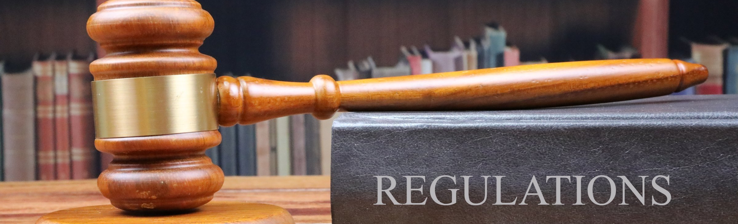
Title 2 CFR Part 200
Establishes uniform administrative requirements, cost principles, and audit requirements (Subparts A-F) for Federal awards to non-Federal entities.
Except for Subpart F, OMB may allow exceptions from requirements for classes of Federal awards, recipients, or subrecipients when the exceptions are not prohibited by statute.
  Federal agencies may also allow exceptions from requirements when the exceptions are not prohibited by law or other approval is expressly required.

Slide 9
Cost Specific Requirements Applicable to CCIs
Title 2 CFR 200 Requirements | Traditional Financial Assistance Award | CCI Award
2 CFR 200.405 Allocable costs. | A cost is allocable to a Federal award or other cost objective if the cost is assignable to that award or other cost objective in accordance with the relative benefits received. | The Service will evaluate the cost in accordance with its benefit to the CCI, rather than the individual State awards. CCI actual costs incurred are allocable to the CCI as the “cost objective”.
2 CFR 200.306 Cost sharing. | For all Federal awards, the Federal agency or PTE must accept cost sharing… when the funds: (3) Are necessary and reasonable for achieving the objectives of the Federal award; | Cost sharing requirements will be met at the CCI level, rather than the individual State awards. (match may be provided by Participating State, CCI Entity, or a third-party entity)

Slide 10
2 CFR 200.306 Cost sharing.
The cost sharing requirements are met at the CCI project (subaward) level, and not at the State (prime) award level.
75% federal
25% state
STATE A
$20,000
Fed = $15,000
Match = $5,000
CCI Recipient
$2,500
Fed = $0
Match = $2,500
CCI Recipient Total
$80,000
Federal = $60,000 75%
Match = $20,000 25%
STATE B
$30,000
Fed = $20,000
Match = $10,000
67% federal
33% state
2 CFR 200.405 Allocable costs.
Evaluate the cost in accordance with its benefit to the CCI, rather than the individual State awards. CCI actual costs incurred are allocable to the project as the “cost objective”.
100% federal
0% state
STATE C
$25,000
Fed = 25,000
Match = $0
Subaward/NGO or other Non-federal Entity
$2,500
Fed = $0
Match = $2,500

Slide 11
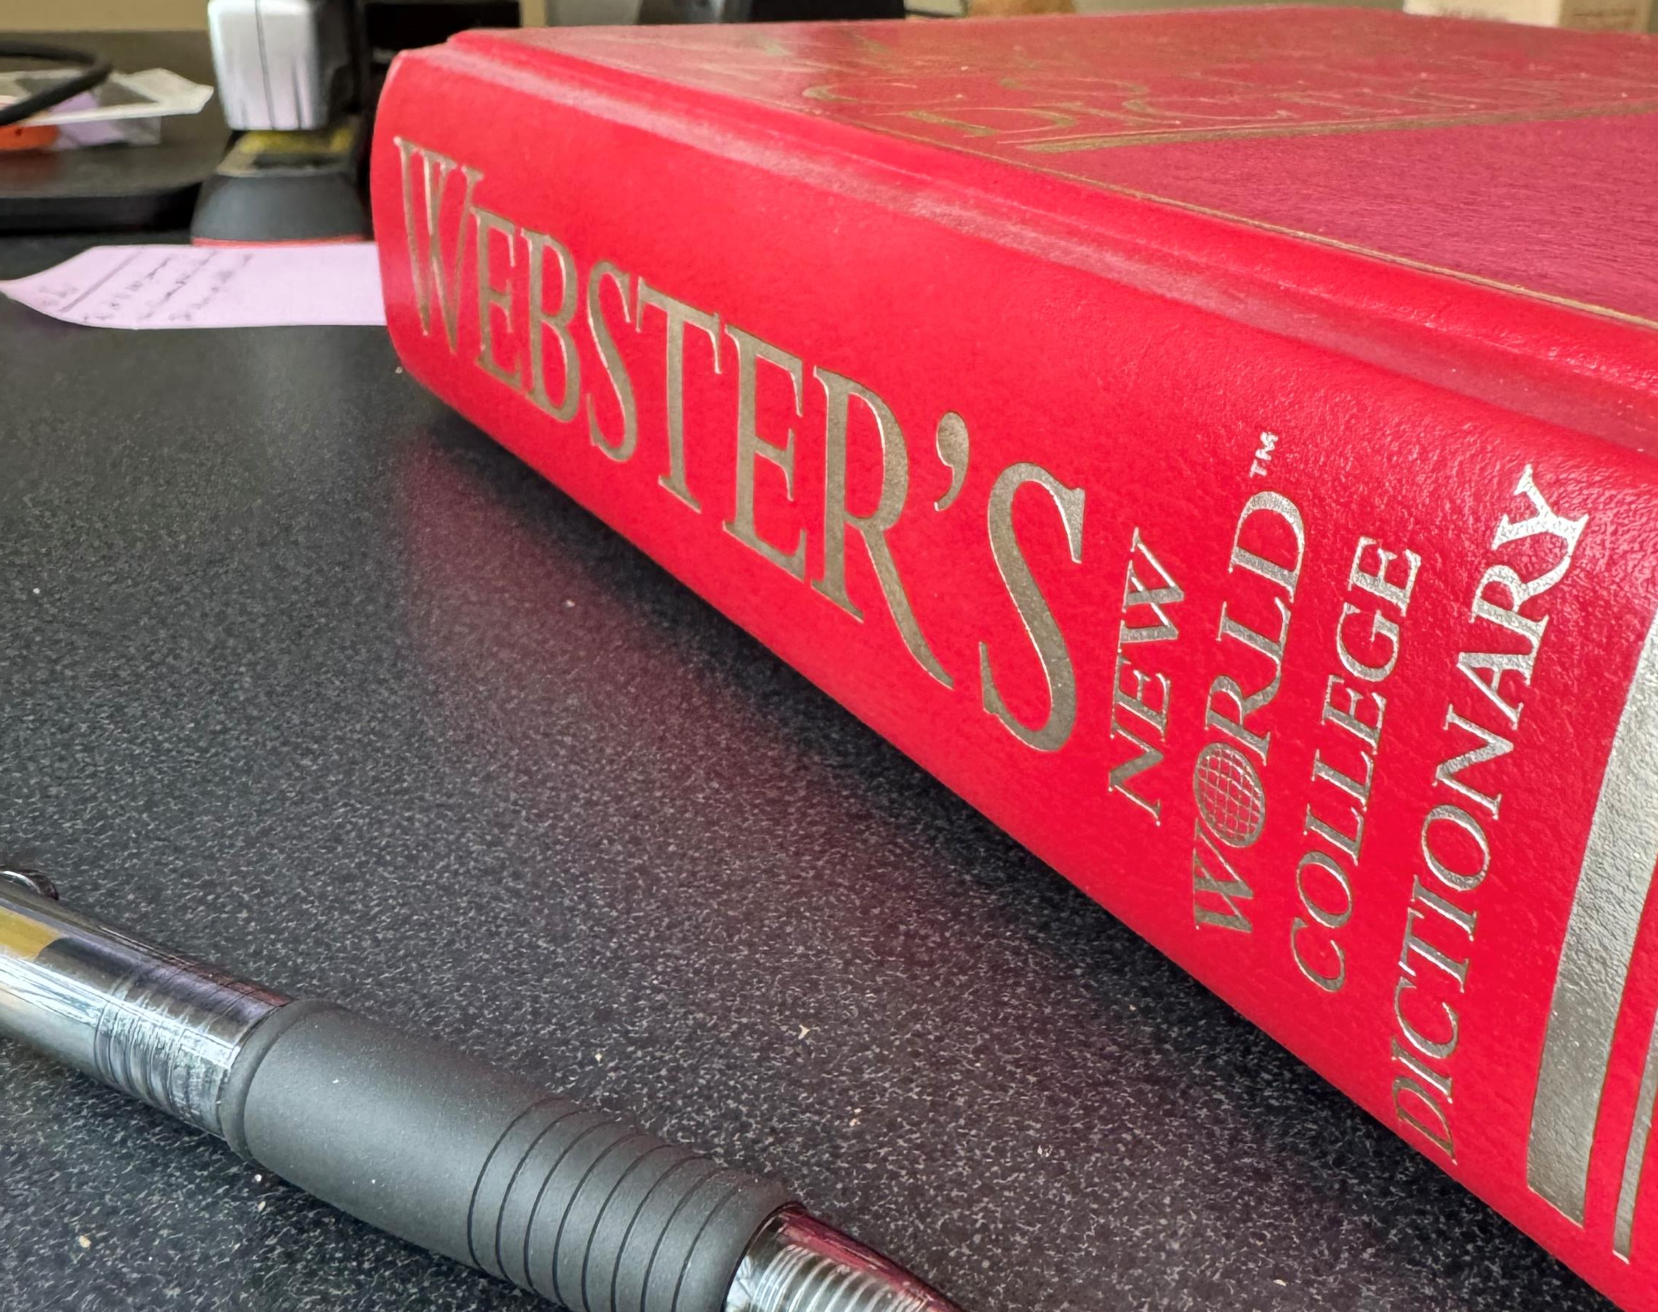
CCI Terminology
CCI Award - a grant to an eligible recipient of WSFR, SWG, or C-SWG funds to support a CCI.
CCI Entity – State, Federal agency, NGO, IHE, or regional AFWA that will manage a CCI.
HQ Point of Contact – HQ Service person providing a central point of coordination for the CCI award administration process. Facilitate coordination and provide communication and administrative support for Service Management and Regional Offices, participating States, the CCI Entity, auditors, etc.

Slide 12
CCI Terminology
Lead Region – Service Region with the most Participating States. If same # of States from two or more regions, then the Lead Region is the region obligating the most funds.
Participating State – a recipient of an award supporting a CCI.
Regional Office Subject Matter Expert – Service staff who provide advice and support to the CCI Entity.
State Team – representatives from at least two Participating States. Must include at least one person with technical knowledge of the CCI project and managing WSFR or SWG financial assistance awards.

Slide 13
CCI Administrative Process
Two or more Participating States have an interest in a collaborative project
Participating States identify a CCI Entity to work with
Participating States and CCI Entity work together to plan project application and budget
Each Participating State signs a Letter of Intent (LOI)
CCI Entity submits application and LOIs using a directed announcement to the Lead Region
FWS will determine eligibility under CCI
Lead Region completes risk assessment
Environmental compliance review is completed
Notice of Award is issued to each Participating State and Notice of Subaward is issued to the CCI Entity
Project work begins
Incurred costs are drawn down according to the draw allocation indicated in the Notice of Award for each Participating State
Notes:
Over the next several slides we will be reviewing the current draft CCI administrative process that we are hoping to get your feedback on over the next month. As you can see on the screen in front of you there are several steps in this process from the initial CCI concept to implementation.

Slide 14

Pre-Application Requirements
Identify State team members
  At least 2 Participating State representatives
  Technical knowledge / grant management experience
Identify "CCI Entity" to manage the project
  State or Federal agency; NGO; IHE; Regional Association
Jointly plan project scope and budget
Notes:
Prior to submitting an application to the Service two or more Participating States that have an interest in working on a collaborative conservation project will identify a state team to guide the initiative.
The state team will include at least 2 Participating State representatives. The State team must include someone with technical knowledge relevant to the project, as well as a Federal Aid Coordinator or other State employee with experience managing WSFR or SWG awards.
The Participating States will then identify a CCI Entity to manage the project. The CCI entity can be a state or federal agency, Non-Governmental Organization, institution of Higher Education or Regional Association
Together the State team members and the CCI entity will develop a single CCI application. The application package must describe how the CCI Entity is qualified to coordinate the work, how they have engaged partners in developing the scope and budget and include budget by cost category. If the budget contains more than one subaccount the application must describe how the costs will be allocated and tracked by the CCI entity.
The state team will ensure that all participating states are aware of the full scope and cost of the CCI prior to submitting an application to the Service.

Slide 15

Application Requirements
Single application package for all Participating States
Single period of performance
Letter of Intent (LOI) from each State
  directs Service to obligate award funds as subaward to CCI Entity;
  identifies any match the State will provide;
  identifies State-specific terms and conditions.
Lead Region provides Directed Announcement for CCI application
Notes:
To apply for funding the Lead Region will develop a Directed Announcement for the CCI application.
The CCI entity will submit a single application package. As part of the application package the CCI entity will need to provide a list of state team members and their qualifications and each participating state will need to submit a letter of intent. The letter of intent will direct the Service to obligate funds from the Participating states apportionment as a subaward from the state to the CCI entity. The letter must identify any match the State will provide and any state-specific terms and conditions they would like to apply to the subaward.

Slide 16

Application Review
Lead Region:
  Will assess for eligibility under CCI
  Performs risk assessment of CCI Entity
  Completes environmental compliance review
  Identifies CCI-specific terms and conditions
For C-SWG, review by National C-SWG Coordinator and HQ POC:
  The HQ POC will assess for eligibility under CCI
  A CCI recommended for funding goes to Lead Region after Directors Memo has been signed
Notes:
Once the application has been submitted the lead region will review the application to ensure that it meets the requirements of a CCI, complete a risk assessment of the CCI entity, complete environmental compliance reviews, and identifies any CCI - specific terms and conditions.
For the C-SWG program – Applications will be submitted through the normal competitive process by the deadline in the NOFO. The National Comp-SWG coordinator will provide the HQ POC with a copy of the application to review to ensure that it meets the requirements of a CCI. This will occur at the same time as the merit review and ranking process. HQ POC will provide to the National C-SWG coordinator a memo stating whether the application meets the requirements for a CCI award or not.

Slide 17

Award Process
Notice of Award to each Participating State
  Identifies non-traditional application of 2 CFR 200 regulations for CCI
Notice of Subaward from GrantSolutions to CCI Entity
  Single obligation to the CCI Entity in GrantSolutions
  Funding line for each State as specified in LOI
  Lists subawards by State
  Lists CCI- and State-specific terms and conditions
  Identifies proper draw allocation for each State award, by subaccount
Notes:
As part of the award process a Notice of Award will be issued to each Participating State informing them that the CCI has been approved, confirming their obligation of funds, and describing their responsibilities to report and monitor the subaward.
A Notice of subaward will also be issued to the CCI Entity, which will include a statement that the funds are subawards, a list of Participating States with subaccounts and amounts, and CCI-specific terms and conditions. The Notice will also describe the rate of participation for each State on which ASAP draws must be based.

Slide 18

Reporting
CCI Entity coordinates with State team in developing reports
  Each State certifies review and acceptance
  CCI Entity submits reports and certifications in GS and TRACS
HQ Compliance Branch reviews ASAP draws by State
Lead Region reviews and approves reports in GS and TRACS
Notes:
The CCI Entity coordinates with State team in developing both financial and performance reports.
A single performance report and single financial report will be prepared for each reporting period.
Each Participating State must provide a signed letter certifying that they have reviewed and accepted the reports.
CCI Entity submits reports and certifications in GS and TRACS
HQ Compliance Branch will review the ASAP draws by state to ensure that incurred costs are drawn down according to the Notice of Subaward.
Lead Region reviews and approves reports in GS and TRACS

Slide 19

Amendments
All amendments:
Signed LOI from each Participating State required and must direct FWS to obligate funds from State’s apportionment when requesting funding
Accepted once a year
Submitted by the CCI Entity in GS
Processed by Lead Region
Notice of Award will be sent to each Participating State
Notice of Subaward will be sent to the CCI Entity and will reflect updated rates of participation for each state
Notes:
The CCI entity will submit amendments in GS.
All amendments must include a signed Letter of Intent from each Participating State.
Requests for increased Federal funding must direct the Service to obligate the funds from each requesting State’s apportionment as a subaward from the State to the CCI entity.
Amendments to a multi-year CCI will only be accepted once per year.
Amendments will be processed by Lead Region
Notice of Award will be sent to each Participating State
Notice of Subaward will be sent to the CCI Entity and will reflect updated rates of participation for each state

Slide 20

Environmental Compliance
Single Region Projects
Compliance evaluations, determinations, and documentation to be completed by that Region based on established procedures.
Multi-Region Projects
Lead Region will coordinate as appropriate with other affected Regions to complete and document compliance determinations, consistent with Region- and partner-specific procedures.
The need for coordination in multi-region projects depends on the project's complexity and potential impact.
Notes:
If a CCI will occur within a Single Region
Compliance evaluations, determinations, and documentation to be completed by that Region based on established procedures.
If a CCI will occur in Multi-Regions
Lead Region will coordinate as appropriate with other affected Regions to complete and document compliance determinations, consistent with Region- and partner-specific procedures.
The need for coordination in multi-region projects depends on the project's complexity and potential impact.

Slide 21
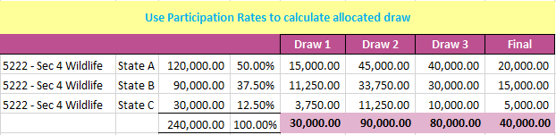
Payments
The CCI Entity must request drawdown in ASAP in proportion to each State’s share of the total Federal funds awarded by subaccount.
Approval to allocate costs in this manner will be on the Notice of Award to each State and in the Notice of Subaward to each CCI Entity.
Notes:
Payments
The subaward to the CCI entity may contain multiple lines of funding from each of the participating states.
The CCI Entity must request drawdown in ASAP in proportion to each State’s share of the total Federal funds awarded by subaccount.
Approval to allocate costs in this manner will be included on the Notice of Award to each State and in the Notice of Subaward to the CCI Entity.
As you can see from the example on the screen the funds for each draw are based on the states share of the total Federal funds by subaccount.

Slide 22

Coming Soon
Share CCI resources and information on FA Wiki.
    Process documents, job aids, FAQs, etc.
    Example resources:
        Sample State Letter Of Intent for a CCI
        Sample Notice of Award to State (CCI award)
        Sample Notice of Subaward (CCI Entity)
        Sample “Certification of State Review of Financial and Performance Reports”
        Sample letter of intent for “Post Award Amendment to CCI Subaward”
        CCI Notice of Subaward conditions

Slide 23

The Path Ahead
Due to its innovative approach, the CCI process will initially be limited to 5-year pilot evaluation period.
  Years 1-3: Pilot phase of CCI award approval and management.
  Year 4: Evaluation of effectiveness and compliance, including audits of CCI awards.
  Year 5: Comprehensive assessment of effectiveness to determine continued use and potential expansion of CCIs to additional programs.

Slide 24
Rollout Plan
Phase I January 22
Webinar for CI staff describing at a high level the need for CCIs, and draft process.
Share draft process documents and flowcharts with CI staff.
Allow 30 days for comment.
CCI Team will edit documents as needed based on CI staff feedback.
Phase II Week of March 7
Webinar for FAC working group and State SME’s.
Share draft process documents and flowcharts.
Allow 2 weeks for comment.
CCI Team will edit documents as needed based on feedback.
CCI Wiki page developed, including FAQs
Phase III April 11
Webinar for all state FACs / SMEs
Share final process documents and flowcharts.

Slide 25

Questions

