Slide 1
ASAP Initiating Payments
To make payments in ASAP:
Log on ASAP using your ID and password
Hover over the Payment Requests Tab
Select “Initiate Payment Requests” from the drop down menu
See the next slide for the screenshot

Slide 2
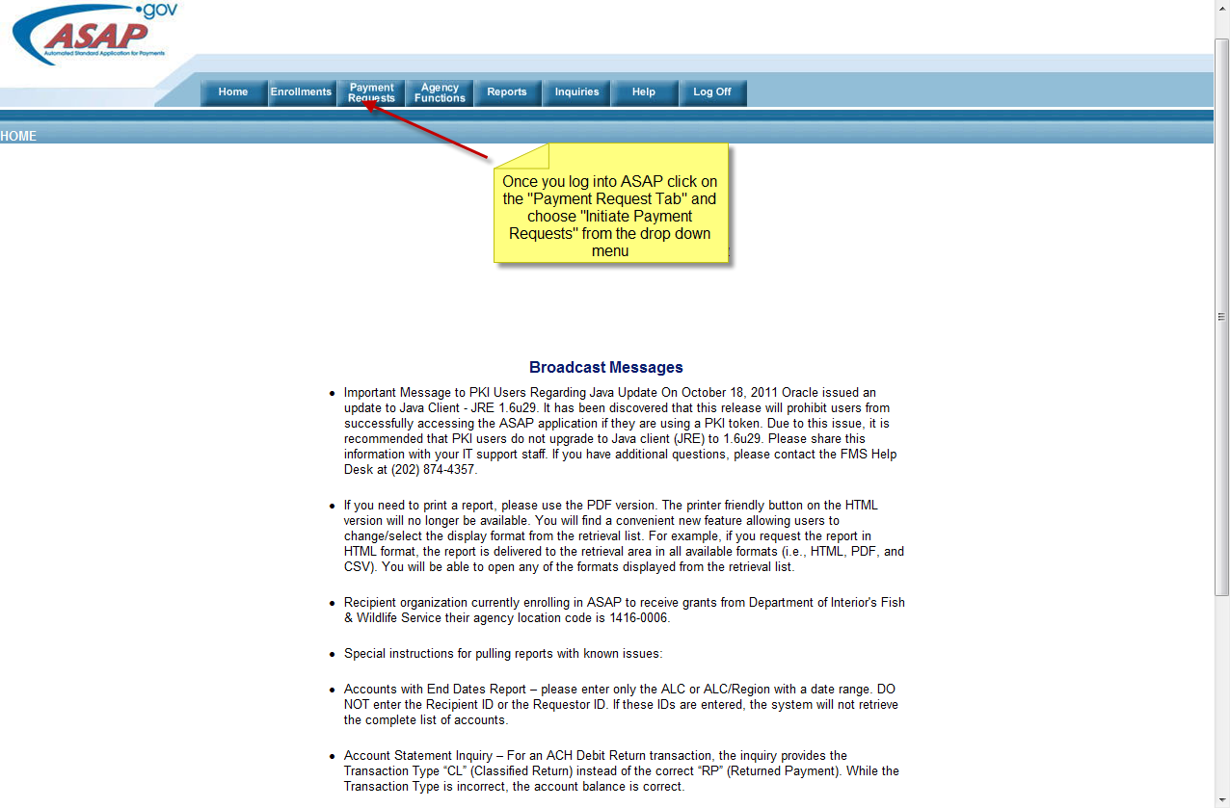

Slide 3
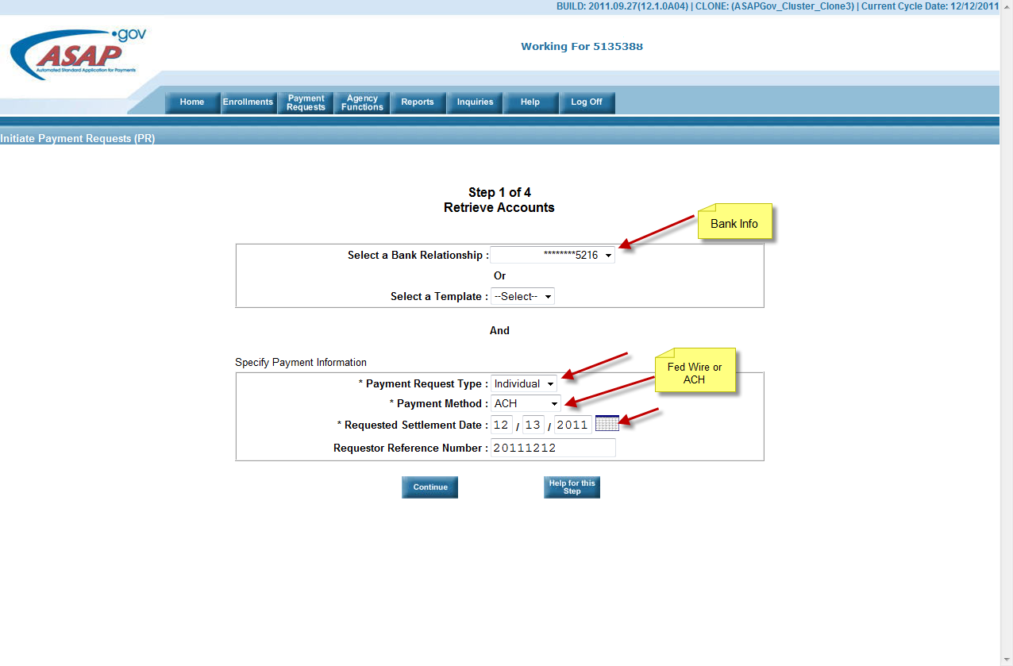
There are 4 steps to making a payment
The fields marked with (*) are necessary
The bank info should prepopulate
For settlement date enter the date you want the payment to clear (next business day)
For payment method you have the choice of ACH or FedWire

Slide 4
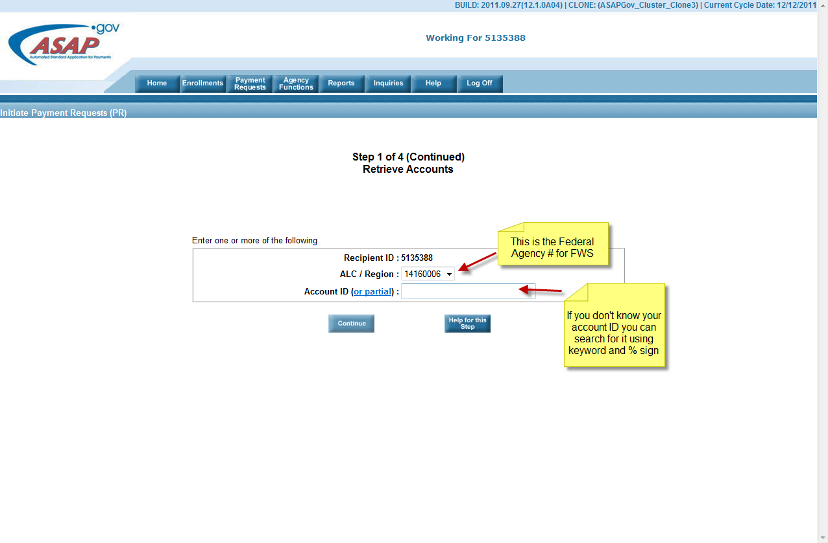
The Recipient ID identifies the Payee
The ALC/Region # is the Fed Agency # and comes from a drop down menu. The one for FWS is 14160006.
The account ID field is searchable using a partial word and % sign- It is the FBMS Award Number

Slide 5
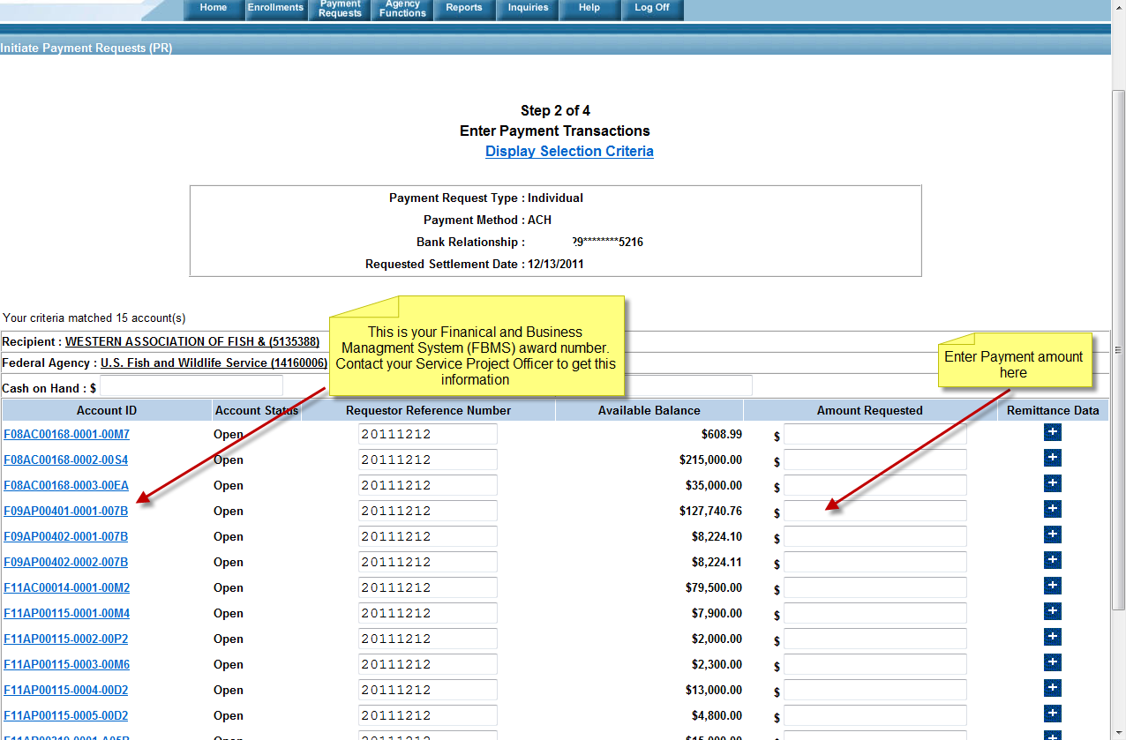

Slide 6
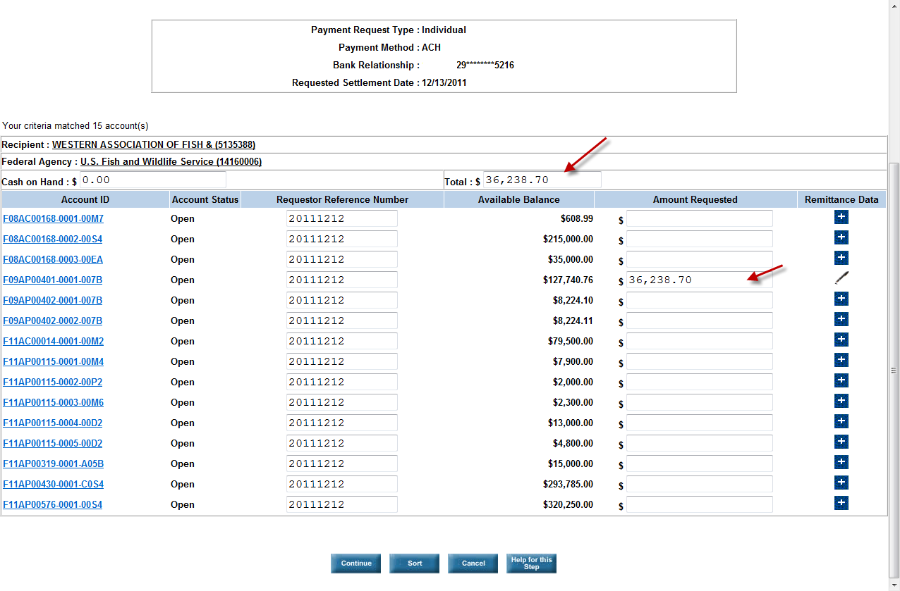
This is the next screen with the payment amount entered

Slide 7
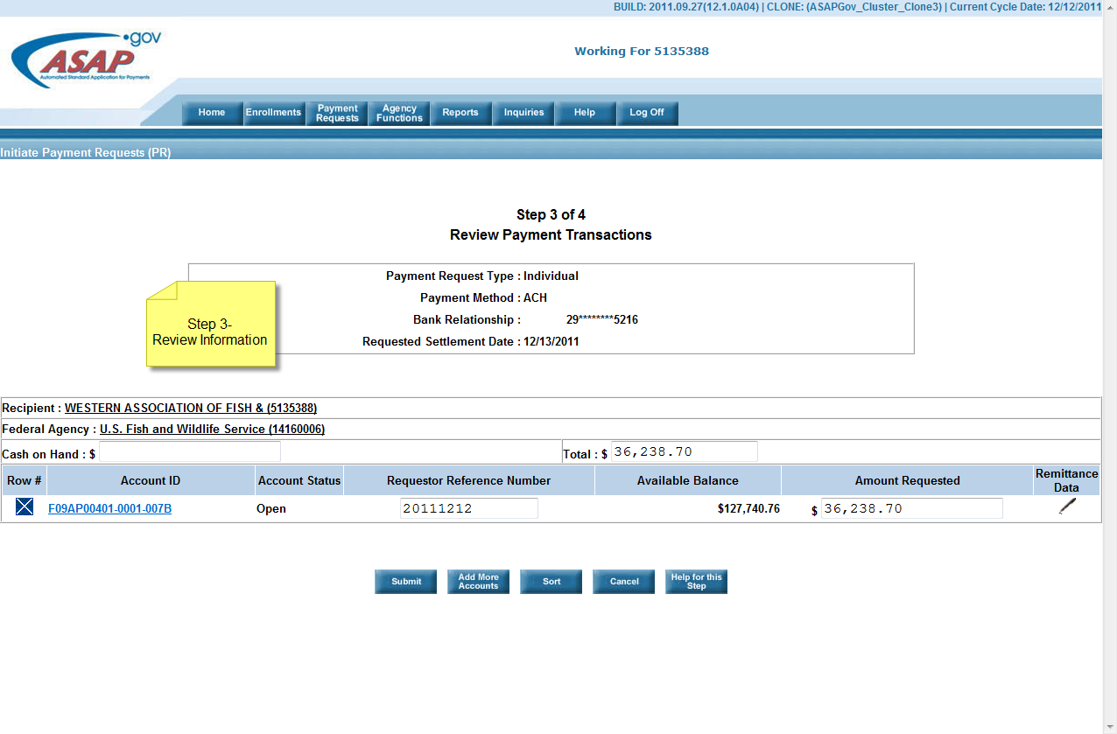
You may review the information you entered at this step, if you need to go back and change anything click on the remittance box outlined in RED

Slide 8
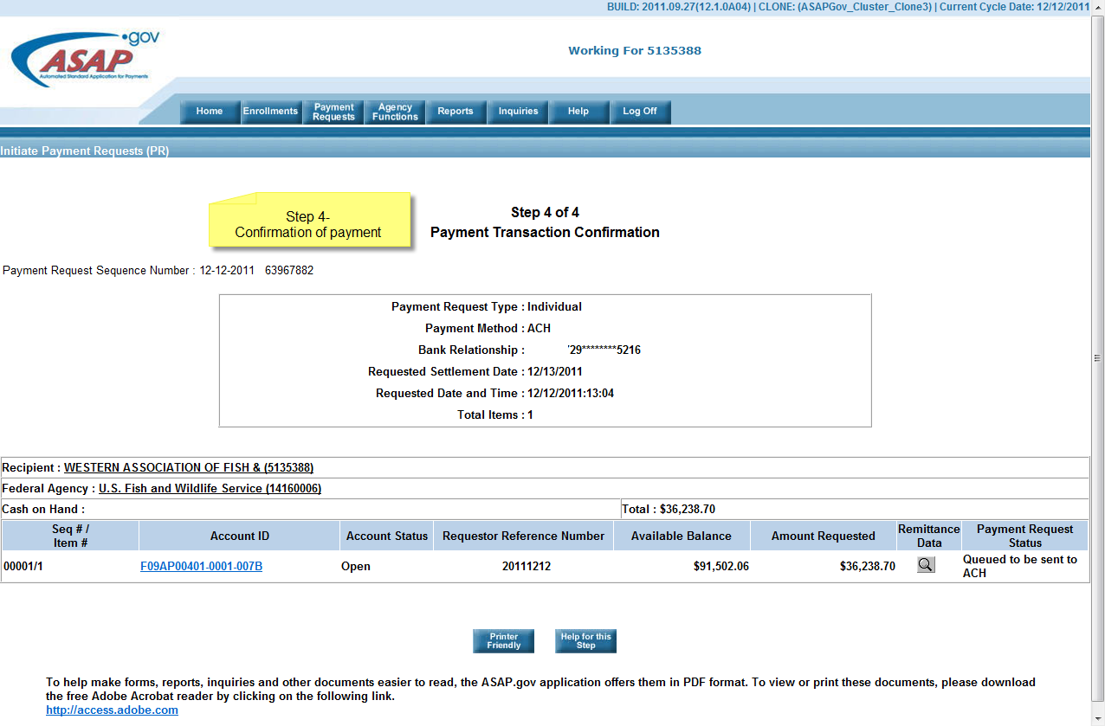

Slide 9
U.S. Treasury ASAP Related Questions
For all U.S. Treasury ASAP related questions include the following information in your email message to fwhqfas@fws.gov
Recipient Name:
Person to Contact:
Phone Number:
ASAP ID:
FBMS Award Numbers (ask your Service Project Officer for this information)
Description of Error Message: Please be very specific. Provide a screen shot if possible.

Slide 10
Other Resources
The following links are useful resources:
Financial Assistance Systems: Payments – ASAP and Waivers
https://inside.fws.gov/index.cfm/go/post/Payments-New
U.S. Treasury-ASAP
http://www.fms.treas.gov/asap/index.html

