Slide 1
ASAP Enrollment
For Financial Assistance Recipients New to ASAP

Slide 2
Step 1:
Initiate Enrollment
Recipient must complete the USFWS ASAP Enrollment Form. The FWS program can obtain the form at http://fawiki.fws.gov/display/ASAP/ASAP+Enrollment+for+Financial+Assistance+Recipients+New+to+ASAP.
Submit the completed form to the FWS program awarding the financial assistance (FA) agreement.
Branch of FA Systems (FAS) will initiate the recipient’s enrollment.

Slide 3
Step 1:
Initiate Enrollment
ASAP will assign the recipient organization’s Point of Contact (POC) a User ID and send an email to the POC with the User ID and a link to set up security questions and passwords.
This step cannot be completed until a temporary password is sent to the POC by regular mail. Rather than wait for the temporary password to be received by regular mail, the POC can call the U.S. Treasury’s ASAP Helpdesk at 855-868-0151 Option 2 Payments, then Option 3, ASAP to request a temporary password.

Slide 4
Step 2:
Confirm Pending Enrollment and Define Officials
After receiving the email notifications from ASAP, the POC has up to 45 days to act on the pending enrollment and define the organization’s officials.
The POC will log into ASAP with the User ID and temporary password given.
Upon initial entry, the POC must accept the role before proceeding.

Slide 5
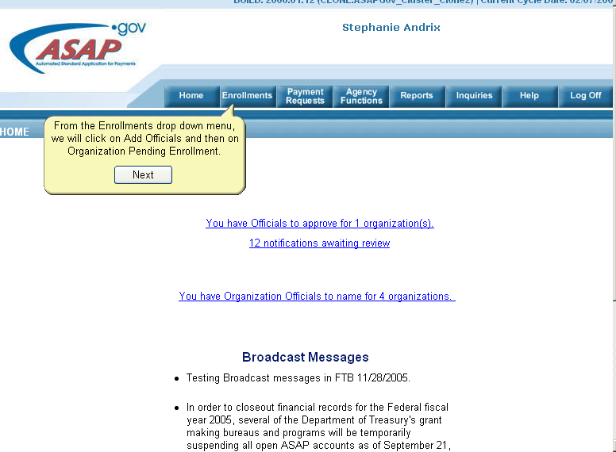
Step 2:
Confirm Pending Enrollment and Define Officials

Slide 6
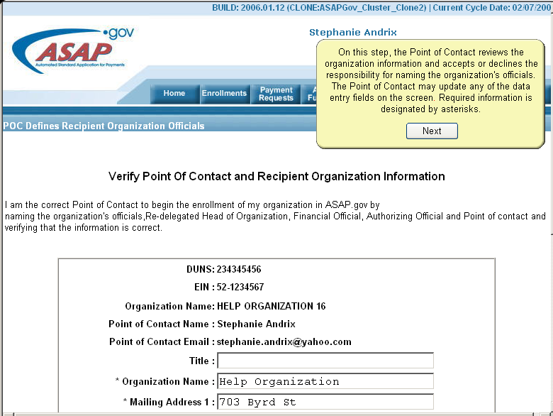
Step 2:
Confirm Pending Enrollment and Define Officials

Slide 7
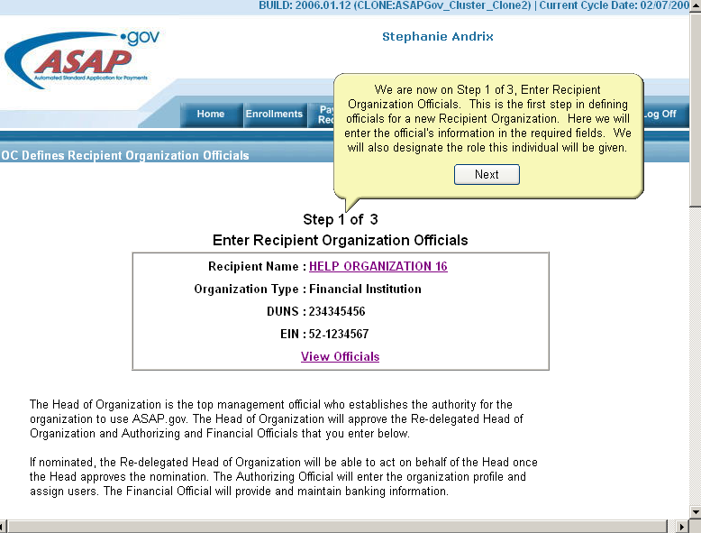
Step 2:
Confirm Pending Enrollment and Define Officials

Slide 8
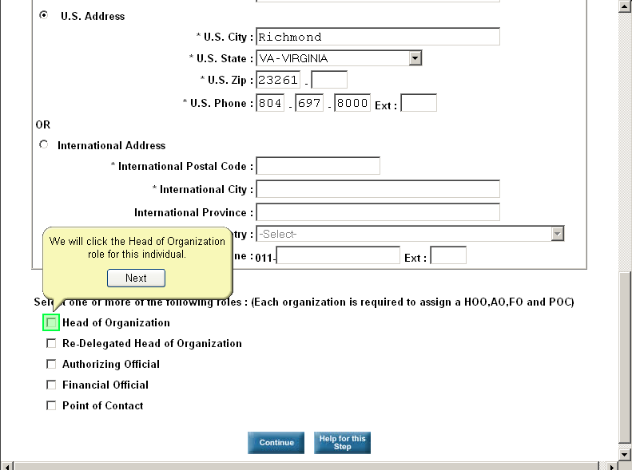
Step 2:
Confirm Pending Enrollment and Define Officials
Define Officials – enter the individual’s information and select the role for this individual.

Slide 9
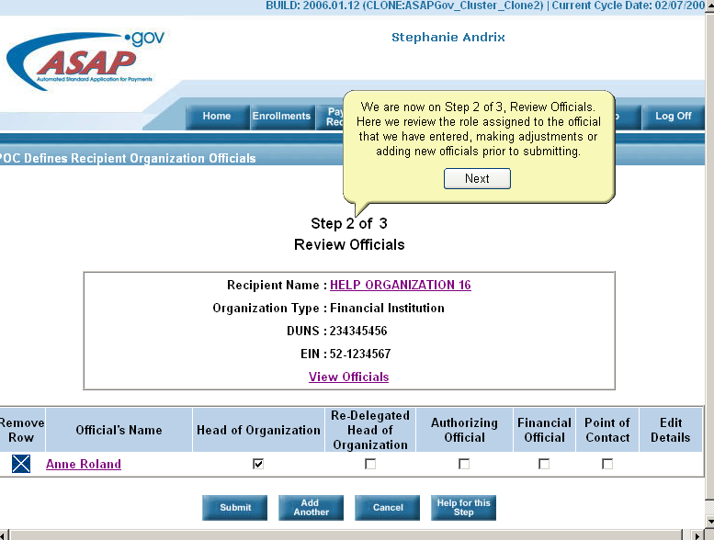
Step 2:
Confirm Pending Enrollment and Define Officials

Slide 10
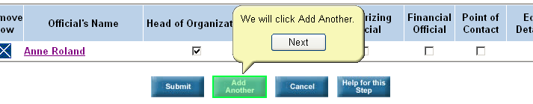
Step 2:
Confirm Pending Enrollment and Define Officials
Add Another Role
  This will take you back to Define Officials screen to add the remaining roles:
    Authorizing Official (AO)
    Financial Official (FO).

Slide 11
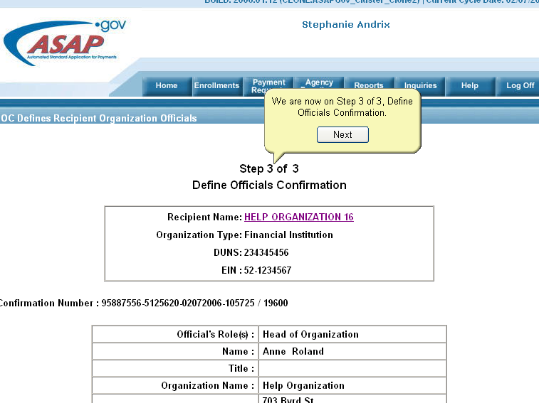
Step 2:
Confirm Pending Enrollment and Define Officials

Slide 12
Step 3: Approve Officials
After receiving email notification, the Head of Organization has up to 45 days to act on a pending enrollment. This is done by approving the Authorizing Official and Financial Official and, if entered by the Point of Contact, the Re-delegated Head of Organization.
Whether the organization is pending enrollment or active, all new and modified officials must be approved, if entered by the Point of Contact, before the changes go into effect.

Slide 13
Step 3: Approve Officials
Once approved, the officials are sent email notifications. As with the previous roles, their User IDs and passwords are sent in separate emails for security purposes.

Slide 14
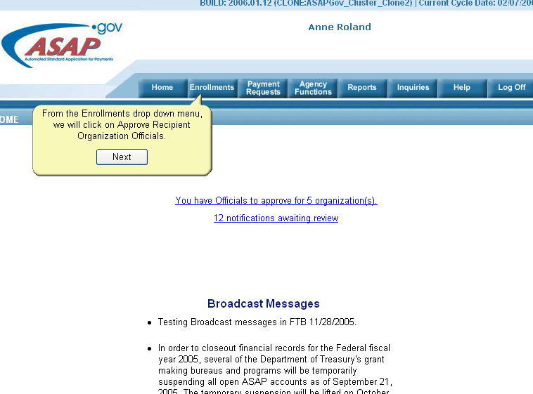
Step 3: Approve Officials

Slide 15
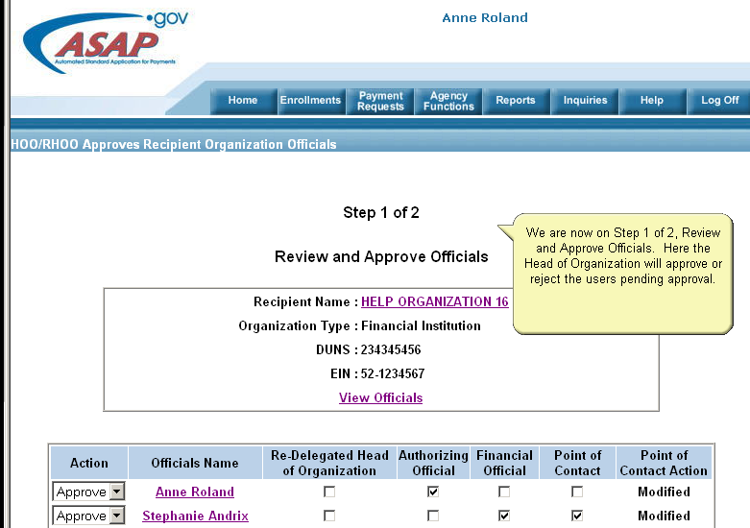
Step 3: Approve Officials

Slide 16
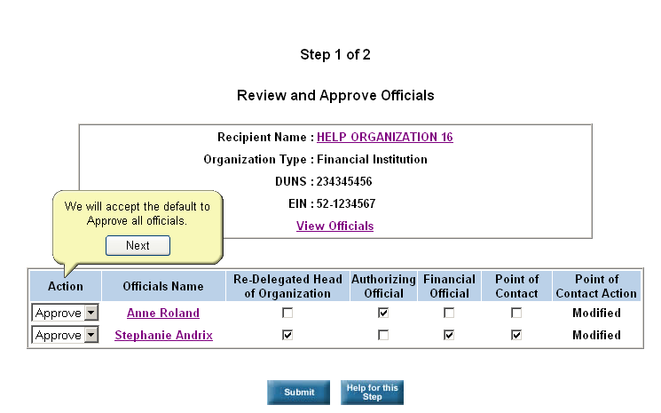
Step 3: Approve Officials

Slide 17
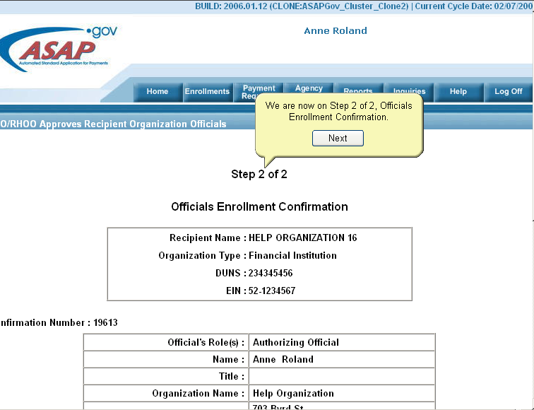
Step 3: Approve Officials

Slide 18
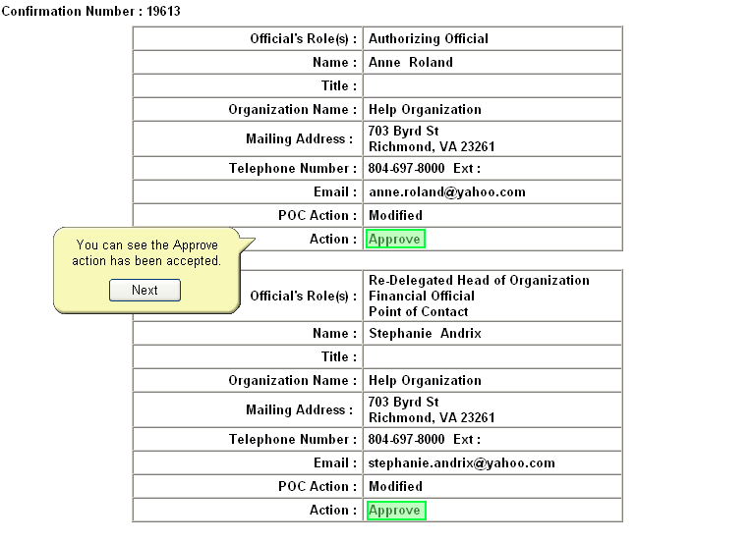
Step 3: Approve Officials

Slide 19
Step 4: Define Users and Roles
Before an organization can become active, the Authorizing Official must complete the organization’s enrollment profile and name the organization’s users. After receiving email notification, the Authorizing Official has up to 45 days to define the Recipient profile.

Slide 20
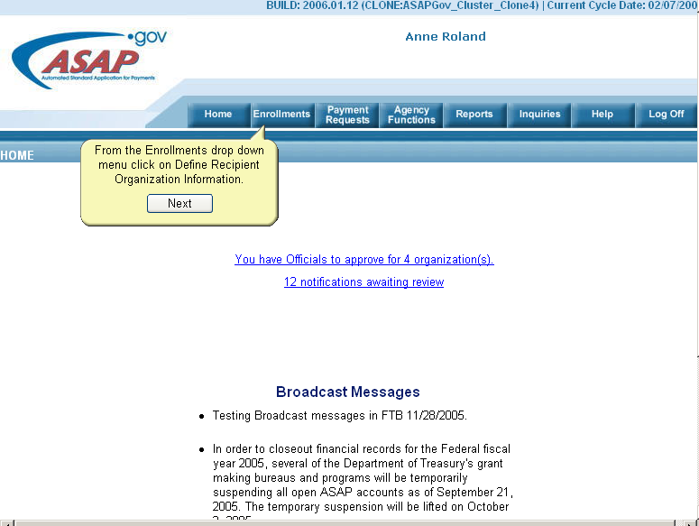
Step 4: Define Users and Roles

Slide 21
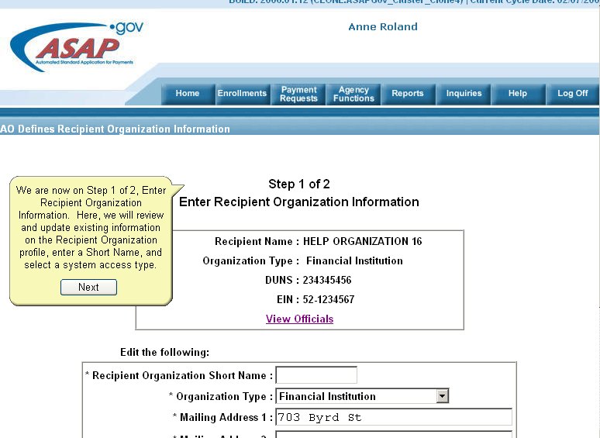
Step 4: Define Users and Roles

Slide 22
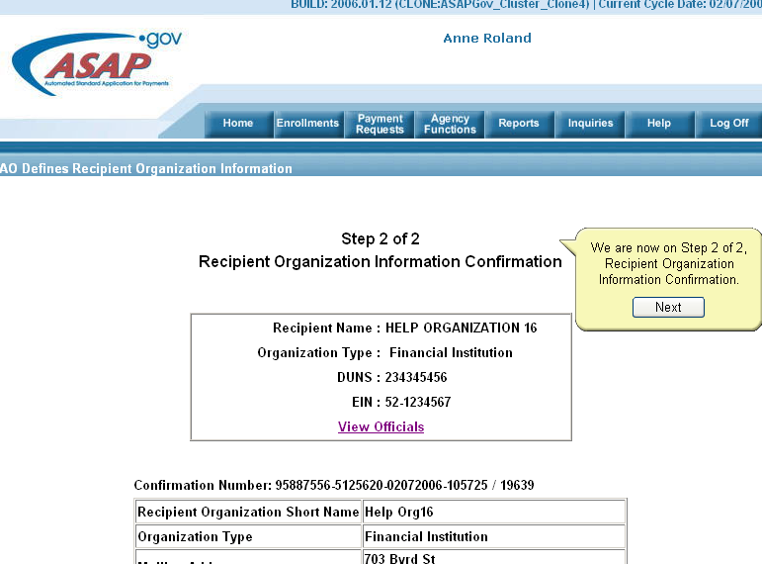
Step 4: Define Users and Roles

Slide 23
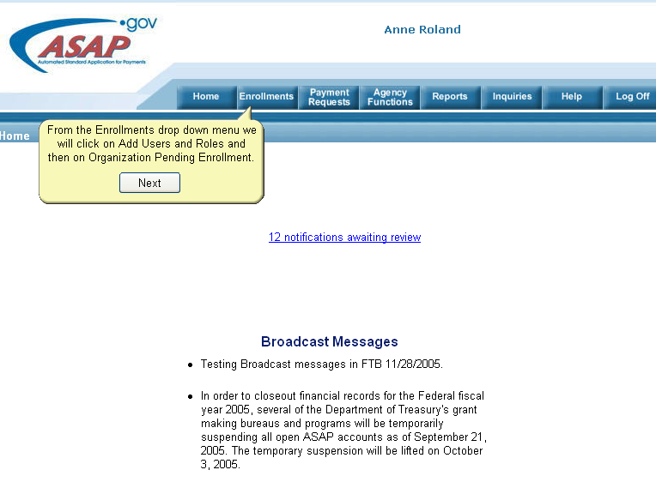
Step 4: Define Users and Roles

Slide 24
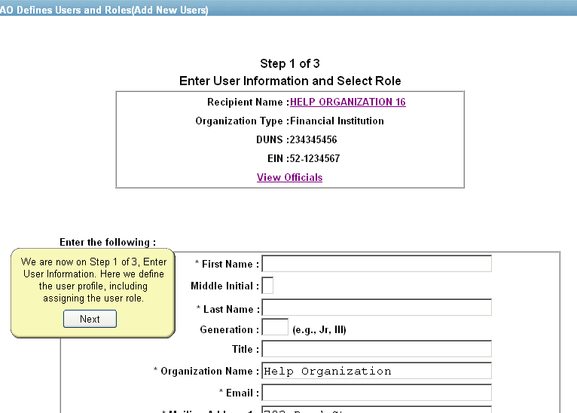
Step 4: Define Users and Roles

Slide 25
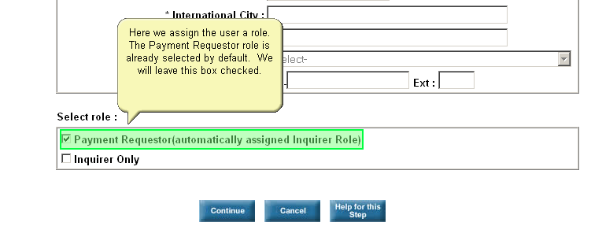
Step 4: Define Users and Roles

Slide 26
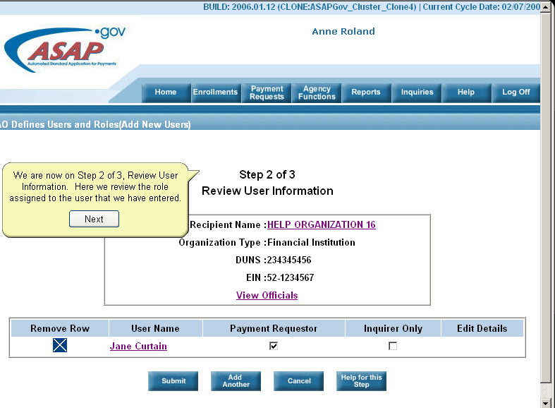
Step 4: Define Users and Roles

Slide 27
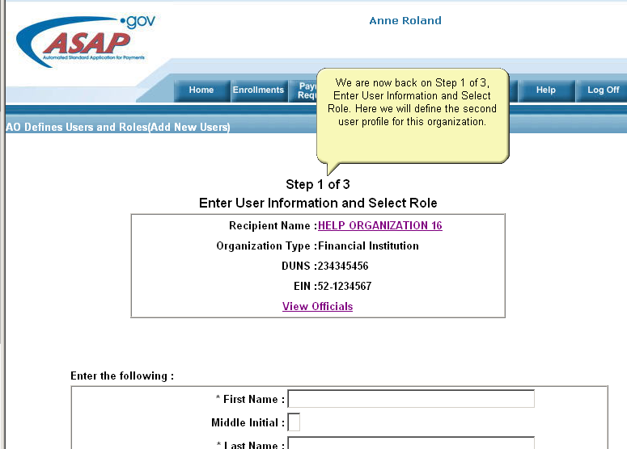
Step 4: Define Users and Roles

Slide 28
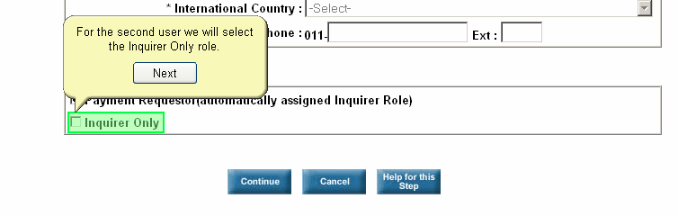
Step 4: Define Users and Roles

Slide 29
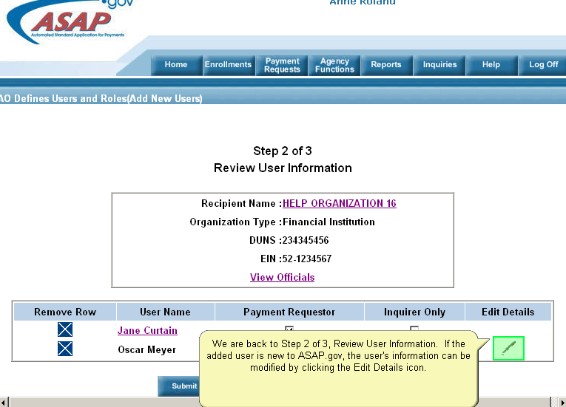
Step 4: Define Users and Roles

Slide 30
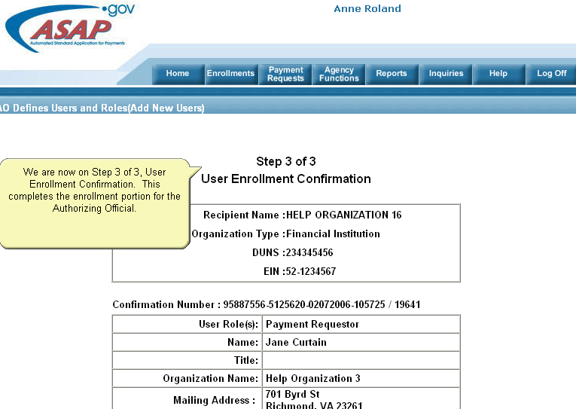
Step 4: Define Users and Roles

Slide 31
Step 5: Add Banking Information
Before an organization can perform payment requests, it must be active and have banking information defined. After receiving email notification, the Financial Official has up to 45 days to add at least one valid bank account.
The Financial Official can add up to 8 unique bank accounts with a corresponding payment method, i.e. 4 with ACH and 4 with Fedwire. A bank account that is designated as “ACH/Fedwire” is counted as 2 separate accounts.

Slide 32
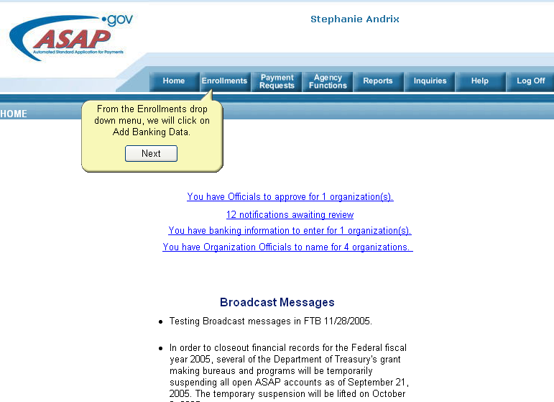
Step 5: Add Banking Information

Slide 33
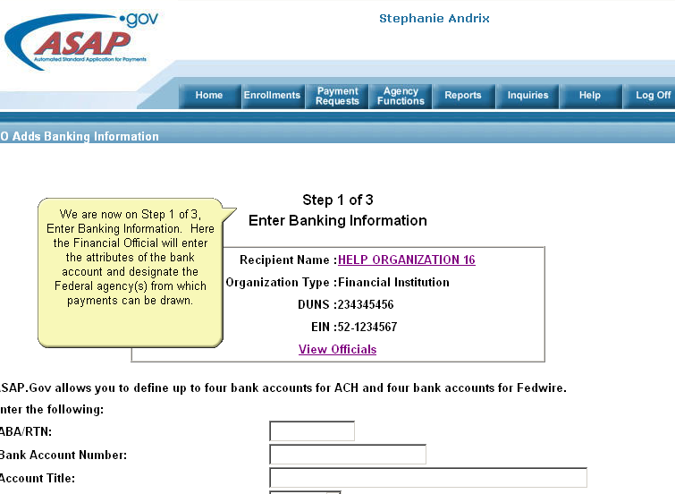
Step 5: Add Banking Information

Slide 34
Step 5: Add Banking Information

Slide 35
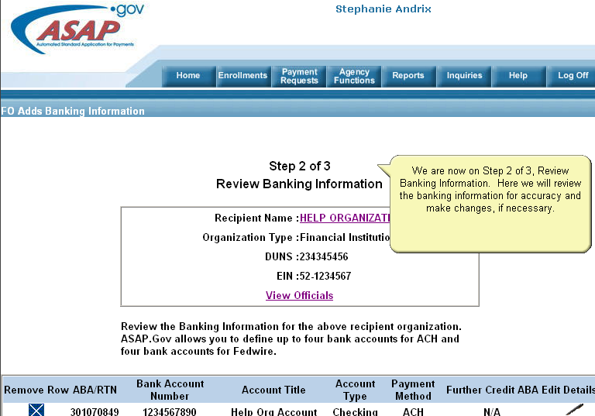
Step 5: Add Banking Information

Slide 36
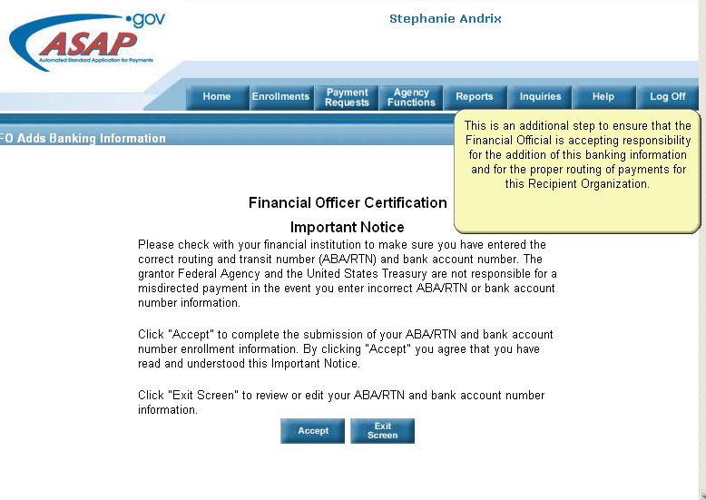
Step 5: Add Banking Information

Slide 37
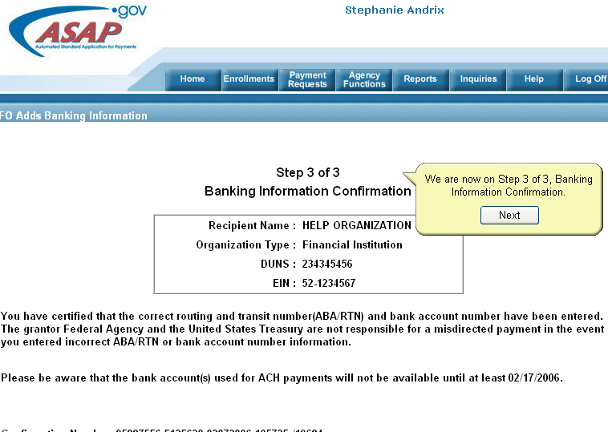
Step 5: Add Banking Information

Slide 38
Step 6: Enrollment Activation
After a new Recipient Organization’s profile is completed by the Authorizing Official and at least one Payment Requestor is defined, the organization is ready to be activated. This is an automated process that occurs within 24 hours after the Authorizing Official satisfies the enrollment requirements.

Slide 39
Step 7: Treasury Validation Period
Even though the enrollment is activated, Treasury imposes a 10 business day bank validation period that begins on the date the Recipient Org Status becomes “Active” during which the federal agency cannot send funds to the newly activated account.
Once the 10 business bank validation period ends, additional steps must be taken by the Branch of Financial Assistance Systems and the FWS program before the funds are made available to the recipient.

Slide 40
U.S. Treasury ASAP Related Questions
For all U.S. Treasury ASAP related questions include the following information in your email message to fwhqfas@fws.gov
Recipient Name:
Person to Contact:
Phone Number:
ASAP ID:
FBMS Award Numbers (ask your Service Project Officer for this information)
Description of Error Message: Please be very specific. Provide a screen shot if possible.

Slide 41
Other Resources
The following links are useful resources:
Financial Assistance Systems: Payments – ASAP and Waivers
http://fawiki.fws.gov/display/ASAP/Automated+Standard+Application+for+Payments+%28ASAP%29+Information
U.S. Treasury-ASAP
http://www.fms.treas.gov/asap/index.html

