Slide 1



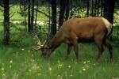
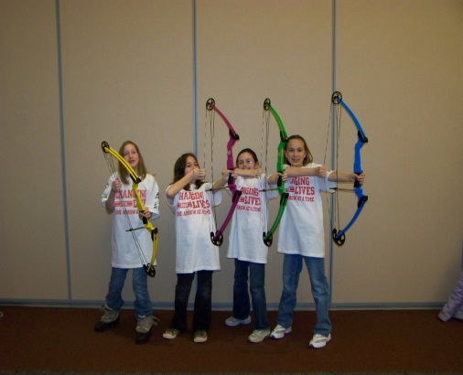
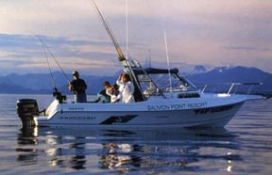
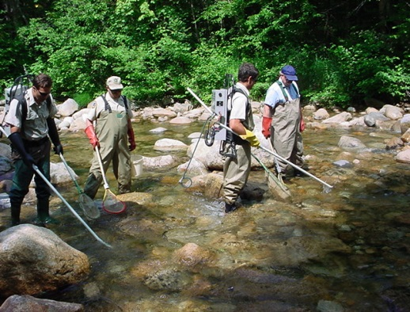
Wildlife & Sport Fish Restoration
Support for R3
R3 Pilot Training
NCTC – Shepherdstown, WV
Phil King
June 14, 2018

Slide 2


Discussion Points
What WSFR program funds are available?
What R3 activities can be funded from each program?
Provide examples of current WSFR funded R3 initiatives.
Notes:
Auditors love to test and question the allowability of costs charged to Federal awards.

Slide 3
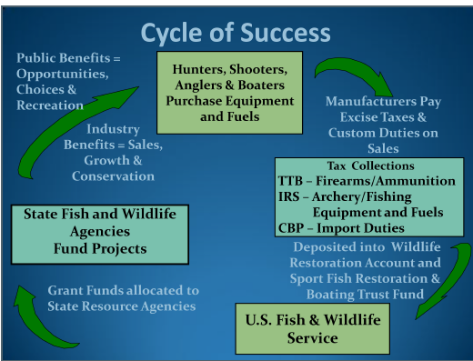
Notes:
Course Leader:
Welcome to the Project Leaders Course.
Instructor introduction and give brief job experience. Have regional representative or co-instructors introduce themselves.
Are all accommodations satisfactory, any difficulties with travel or issues to be resolved? If so, please see the course coordinator.
Thank state coordinator or contact for assisting with course arrangements.
Thanks for being here and working with us.
Housekeeping:
Location of restrooms, break area, telephones.
Announcements / messages are posted on message board located in break area.
Please turn off or put your cell phones and pagers on silent.
Course Material:
Everyone should have a course notebook. The notebook contains handouts that will be used in class.
We’ll be working in pairs and groups on exercises throughout the course.
Parking Lot – You may ask questions anytime during the course. If we cannot immediately answer the question we will write it down and post it on the question parking lot. The question may be answered later in the course or if it isn’t we’ll get an answer as soon as possible.
Everyone should have completed pre-course work online courses.
Evaluation Form –Tell participants at the end of the course there will be evaluation forms and we would like their feedback. Explain that these are important tools for improving future courses.

Slide 4


Wildlife Restoration Receipts by Category
Notes:
Over last 10 years, Gains across all categories, particularly Pistols/Revolvers ($50 M to $250 M) and Ammunition ($100 M to $250 M)
But again, levelling off in last 5 years

Slide 5


11% Tax Firearms and Ammunition | 10% tax Pistols, Handguns and Revolvers | 11% tax Bows, Quivers, Broadheads, Points, and $.51 per shaft | Interest from the Trust Fund
Wildlife Restoration Trust Fund
Multi-State Conservation $3M | WR Admin – Fixed w/CPI adj | Interest to NAWCA Reverted Funds to Migratory Birds
States – Wildlife Restoration 77.8% | Basic Hunter Education | Enhanced Hunter Education $8M

Slide 6
Wildlife and Sport Fish Restoration
Wildlife Restoration Apportionment
U.S. Fish and Wildlife Service
Final Apportionment of Pittman-Robertson
Wildlife Restoration Funds for Fiscal Year 2018
Notes:
Each fiscal year States’ receive four apportionments under the Wildlife Restoration Act, one for Wildlife Restoration, one for the previous year’s Section 10 Hunter Education reverted funds, Section 10 reverted funds are the funds that were returned to be re-apportioned to States that met eligibility. They become, in effect, Wildlife Restoration – 2 year funds, and one for each Section 4 Hunter Education, and Section 10 Hunter Education.

Slide 7
Costs – Determining Allowability
Federal Cost Principles of allowable costs.
Necessary / reasonable +
Properly allocated +
Adequately documented =
Allowable
2 CFR 200.402
Notes:
Auditors love to test and question the allowability of costs charged to Federal awards.

Slide 8
Factors affecting Allowability
Authorized / not prohibited under State or local laws or regulations.
Comply with laws, terms/conditions, governing regulations (exclusions in the Federal award program).
The eligible activities under each of the funding categories are outlined in the respective sections of 16 U.S.C. 669-669k, as amended.
2 CFR 200.403
Notes:
How do I know what costs can be coded or charged to my project?
Two broad principles to take into consideration:
Necessary/ Reasonable
Proper allocation of costs to projects
Most common audit finding—questioned costs. Project leaders need to become familiar with federal cost principles-you are often on the front line in determining allowable costs.
Allocable= costs should be allocated to projects or activities in proportion to benefits received.
Compliance with law/regs- Can’t use DJ $ for non-game fish (darters).
Can’t apply different standards or accounting procedures to federal awards.

Slide 9
WR Eligible R3 Activities
Acquire real property suitable or capable of being made suitable for public access for hunting or other wildlife-oriented recreation.
Build structures or acquire equipment, goods, and services to provide public access for hunting or other wildlife-oriented recreation. (parking lots, kiosks, duck blinds, tree stands….)
50 CFR 80.50

Slide 10
WR Eligible R3 Activities
Research and surveys that assess trends in hunter participation, including recruitment and retention, socio-economic studies and barriers to hunting.
Acquire, lease or manage lands to increase hunting opportunity.
Develop facilities to support hunters, hunting and wildlife-related recreation. (education building)
Conduct tests to evaluate the results of recruitment
and retention techniques.
USFWS Guidance

Slide 11
Basic HE Eligible R3 Activities
Teach the skills, knowledge, and attitudes necessary to be a responsible hunter.
Construct, operate, or maintain firearm and archery ranges for public use.
50 CFR 80.50

Slide 12
Basic HE Eligible R3 Activities
Assess the effectiveness of hunter education programs on recruiting and retaining participants.
Develop / implement recruitment & retention programs provided the activities teach skills, knowledge, and attitudes necessary to be a responsible hunter. (skill clinics, mentored hunts…)
Improve access to hunter education materials and courses (online delivery)
USFWS Guidance

Slide 13
Basic HE Eligible R3 Activities
Acquire land, construct and operate firearm and archery ranges.
Acquire, develop and maintain hunter education facilities.
Provide technical assistance to range operators.
USFWS Guidance

Slide 14
Enhanced HE Eligible R3 Activities
Develop and implement model recruitment and retention programs.
Shooting skills development programs: Archery in the Schools and Scholastic Clays
Develop and sponsor exhibits at outreach events.
USFWS Guidance

Slide 15
Enhanced HE Eligible R3 Activities
Increase opportunities for recreational shooting: mobile shooting clays and live fire exercises.
Acquire and maintain facilities that encourage hunting, firearms and archery activities; and communicate positive hunting messages through media programs.
USFWS Guidance

Slide 16
Eligibility of Stocking Pen-Raised Birds?
If a State project proposal reasonably justifies how its pen-raised bird program will further the recruitment, retention, and reactivation of hunters and has an evaluation component to determine the effectiveness of the program to meet these objectives, and all other aspects of the proposal meet the standards of the Wildlife Restoration Act and its implementing regulations at 50 CFR Part 80, then the Regional Director may consider the project eligible for funding under the Section 4(c) and 10 Hunter Education and Safety Programs.
12/01/2017
Director Memorandum

Slide 17


10% Excise Taxes Fishing equipment / trolling motors | 1%-2.7% Import Duties Pleasure boats and yachts | Fuel Tax Highway Trust Fund motorboat/small engine fuel | Interest from Trust Fund
Sport Fish Restoration and Boating Trust Fund
SF and Boating Partnership Counsel $400K | Multi-State Conservation $3M | Fisheries Commissions $800K | SFR Admin – fixed w/CPI adj
CVA / BIG Program 4% | Nat’l Outreach / Communication (RBFF) 2% | RBS Program17.3% | Coastal Wetlands 18.6% | States SFR (ARE)/ (Boat Access) 58%

Slide 18
Sport Fish Restoration &
Boating Trust Fund Receipts
Notes:
Big driver for SFR is gas taxes, which provide 72% of receipts

Slide 19
SFR Eligible R3 Activities
Stock fish for recreational purposes.
Build structures, acquire equipment, goods, and services to provide public access for sport fishing.
50 CFR 80.51

Slide 20
ARE Eligible R3 Activities (15%cap)
Grants with the purpose of the enhancement of the public's understanding of water resources, aquatic life forms, and sport fishing, and the development of responsible attitudes and ethics toward the aquatic environment.
Examples: Angler education courses and clinics, teacher training
50 CFR 80.51

Slide 21
Outreach and Communications Eligible R3 Activities
Improve communications with anglers, boaters, and the general public on sport fishing and boating opportunities.
Increase participation in sport fishing and boating.
50 CFR 80.51

Slide 22
WSFR Initiatives in Support of States
Establish Regional Coordination
Increase and share knowledge of WSFR R3 program accomplishments
Clarity/flexibility on eligible activities

Slide 23
Director’s Initiatives in Support of States
Increase Public Access
Availability of Resource
Align hunting regulations and season dates
Reasonable & understandable regulations
Affordability

Slide 24
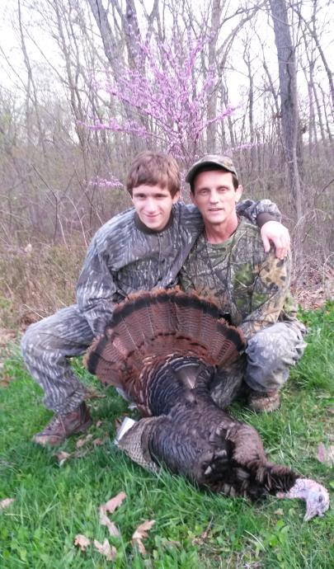
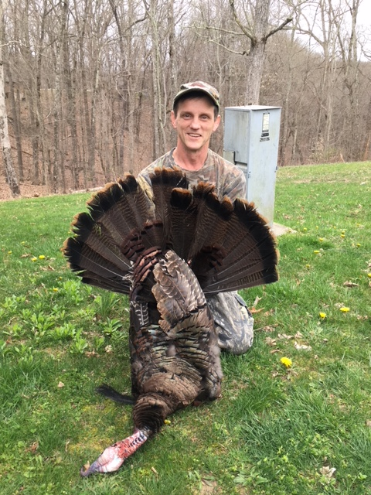
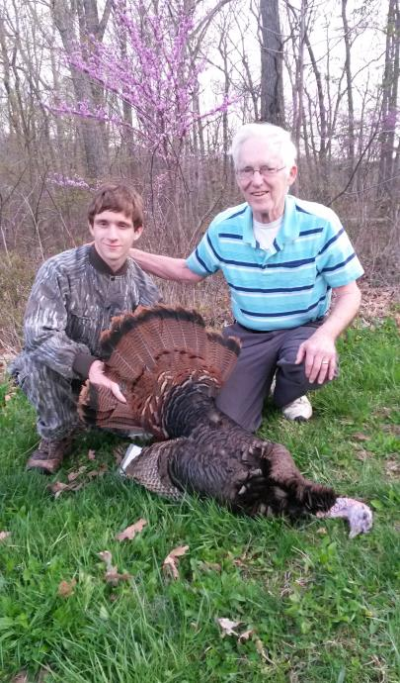

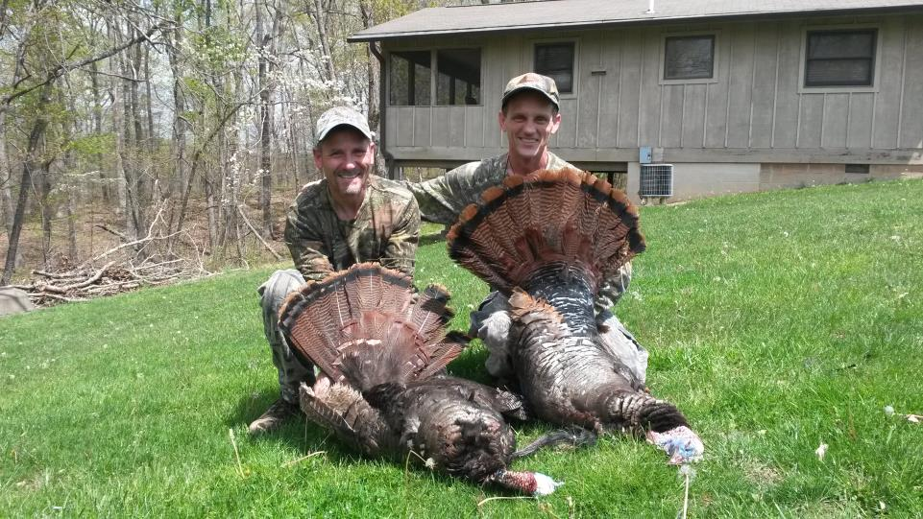
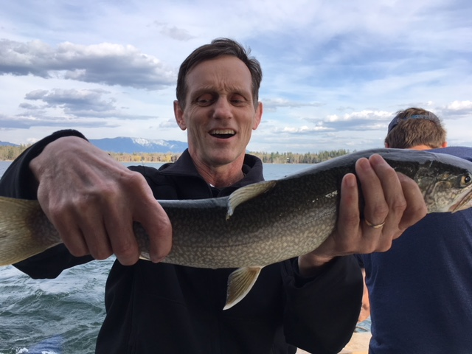
Notes:
UG continues to be interpreted via FAQs, now Compliance Supplements (published by OMB annually, usually in the late Spring). Can find this on Whitehouse.gov (I also keep current document on the BFA Toolkit).

Slide 25
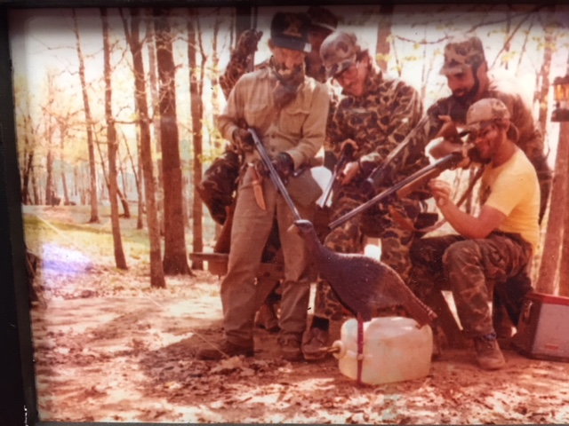
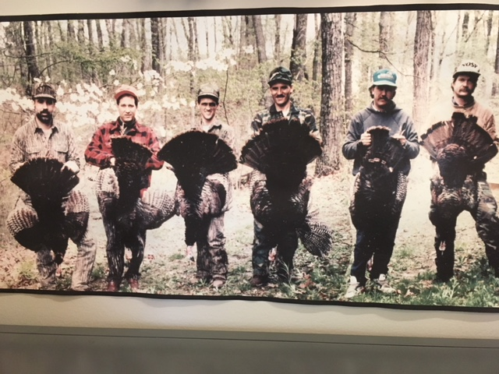
Notes:
UG continues to be interpreted via FAQs, now Compliance Supplements (published by OMB annually, usually in the late Spring). Can find this on Whitehouse.gov (I also keep current document on the BFA Toolkit).

Slide 26

Questions?
Notes:
Address any Questions / Parking Lot Issues
More information on Grants Management – Advanced Course, Project Leaders Courses, more to come.
Remind participants they will receive digital versions of the powerpoint with instructor notes and workbook that has all answers to exercises included.
Post –Course Survey (10 Minutes)
Ask participants to complete evaluation.
Distribute Course Certificates

